Slide 1
Power Consideration for Composite Endpoint in Randomized Clinical Trials
Doctoral Oral Qualifying Exam
Lan Shi, MS

Slide 2
Overview
Section 1: Background
Shi, L., Lindsell, C.J., Liu, D. Trends in Use of Composite Endpoints in Clinical Trials: A Comparison between Acute Heart Failure Trials and COVID-19 Trials. Journal of Clinical and Translational Science, 1–14. doi:10.1017/cts.2024.492
Section 2: Simulation Study - Understand the Power of Composite Endpoints related to Components
Time-to-first-event (Survival)
Binary/Ordinal
Section 3: Plan for Paper 1 - Power Consideration of Ordinal Composite Endpoints
Existing methods and Limitations
Proposed Work
Notes:
Overall goal is to understand the use of composite endpoints in clinical trials
Where first section is the literature review about the existing use of CE
Also from review of literatures, currently no literatures talking about power calculation for composite endpoints ??????? => Check literatures:
Dandan: all the methods are still based on survival outcomes, then just treat CE as one survival, rather than considering how different components play a role, same thing for ordinal.
Next step: use simulation to understand whether different components in how we defined CE are impacted by their underlying relationship.

Slide 3
Section 1: Background Trends in Use of Composite Endpoints in Clinical Trials: A Comparison between Acute Heart Failure Trials and COVID-19 Trials.
Notes:
15min

Slide 4




Section 1: Background - Trends in Use of Composite Endpoints in Clinical Trials
1.1 Introduction
Composite Endpoints
Increasingly adopted in clinical trials, especially in diseases with complex presentations like acute heart failure (AHF) or coronavirus disease (COVID-19)
Encoding multiple pieces of information into single variables
Minimize sample size needs, shorten follow-up durations, and cut costs
Evolution of the use of composite endpoints
AHF
COVID-19
Notes:
Can add reference to second bullet point.
Composite endpoints are like a mixed bag of results used in studies, especially when testing new treatments. Instead of just looking at one thing, like whether a medicine lowers blood pressure, you look at several things at once, like lowering blood pressure, reducing heart attacks, and preventing strokes. By putting these different outcomes together, you get a clearer picture of how well the treatment works overall.
Take advantage of the feature of composite, so….
Evolution is mainly driven by the goal of making clinical trials better at detecting how a treatment works on all aspects of a disease.
Can remove, mention in words. Don’t read.
Present the paper: 15 min, following the JAMA slides of collaboration 2 class.
One sentence summary/conclusion: the difference between covid and AHF in terms of use of ordinal outcome is for covid there is a strong voice like WHO and other association to put out some guidance.
Information about the evolution cannot be shown through our result, so need to show our literatures. (list key messages in our introduction)
The difference in the evolution
Why the use of composite endpoint is promoted so quickly.
Evolution of endpoints
Side by side (two diseases)
Provide context

Slide 5
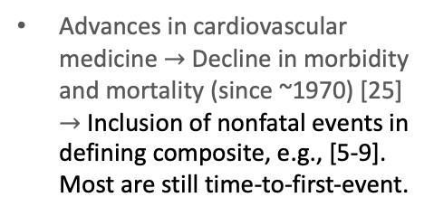
Section 1: Background - Trends in Use of Composite Endpoints in Clinical Trials
1.1 Introduction (Cont.)
Composite Endpoints Evolution Process – Acute Heart Failure
New ordinal composite in chronic heart failure trials [10] (2001), and later adapted to AHF trials [11] (2016)
Advanced statistical analysis methods, e.g., win ratio [13] (2012), global ranking [14][15] (2008)
FDA guidance clarifies that therapies for treating heart failure can be approved based on their effect on symptoms or physical function [12](2020). More inclusion of patient-oriented outcomes.
Advances in cardiovascular medicine $→$ Decline in morbidity and mortality (since ~1970) [25] $→$ Inclusion of nonfatal events in defining composite, e.g., [5-9]. Most are still time-to-first-event.
First developed [2] (1990) [3] (1993)
1990
2000-2020
2020
2007
Half of cardiovascular trials have adopted a composite endpoint inclusive of morbidity and mortality [4] (2007)
There is a clear trend to study AHF treatments using composite endpoints as mortality rates decline, and improving how a patient feels and functions become the primary motivator.
Notes:
Sp: what year seem to be year that people propose hierarchical clinical composite.
Win ratio/Global ranking still starts later than decline in mortality.
Don’t use circle, use year Change circles to same size
[2]Califf RM, Harrelson-Woodlief L, Topol EJ. Left ventricular ejection fraction may not be useful as an end point of thrombolytic therapy comparative trials. Circulation American Heart Association, 1990; 82(5): 1847–1853.
[3]Braunwald E, Cannon CP, McCabe CH. Use of composite endpoints in thrombolysis trials of acute myocardial infarction. The American Journal of Cardiology 1993; 72(19): G3–G12.
[4]Ferreira-González I, Busse JW, Heels-Ansdell D, et al. Problems with use of composite end points in cardiovascular trials: systematic review of randomised controlled trials. BMJ (Clinical research ed.) 2007; 334(7597): 786.
[5]Hussain A, Misra A, Bozkurt B. Endpoints in Heart Failure Drug Development. Cardiac Failure Review 2022; 8: e01.
6. Fox K, Ford I, Steg PG, Tendera M, Ferrari R, BEAUTIFUL Investigators. Ivabradine for patients with stable coronary artery disease and left-ventricular systolic dysfunction (BEAUTIFUL): a randomised, double-blind, placebo-controlled trial. Lancet (London, England) 2008; 372(9641): 807–816.
7. Boden WE, van Gilst WH, Scheldewaert RG, et al. Diltiazem in acute myocardial infarction treated with thrombolytic agents: a randomised placebo-controlled trial. Incomplete Infarction Trial of European Research Collaborators Evaluating Prognosis post-Thrombolysis (INTERCEPT). Lancet (London, England) 2000; 355(9217): 1751–1756.
8. Brugaletta S, Gomez-Lara J, Ortega-Paz L, et al. 10-Year Follow-Up of Patients With Everolimus-Eluting Versus Bare-Metal Stents After ST-Segment Elevation Myocardial Infarction. Journal of the American College of Cardiology 2021; 77(9): 1165–1178.
9. Lindenfeld J, Zile MR, Desai AS, et al. Haemodynamic-guided management of heart failure (GUIDE-HF): a randomised controlled trial. Lancet (London, England) 2021; 398(10304): 991–1001.
13. Pocock SJ, Ariti CA, Collier TJ, Wang D. The win ratio: a new approach to the analysis of composite endpoints in clinical trials based on clinical priorities. European Heart Journal 2012; 33(2): 176–182.
14. O’Brien PC. Procedures for comparing samples with multiple endpoints. Biometrics 1984; 40(4): 1079–1087.
15. Felker GM, Anstrom KJ, Rogers JG. A global ranking approach to end points in trials of mechanical circulatory support devices. Journal of Cardiac Failure 2008; 14(5): 368–372.
half of cardiovascular trials have adopted a composite endpoint inclusive of morbidity and mortality
Present the paper: 15 min, following the JAMA slides of collaboration 2 class.
One sentence summary/conclusion: the difference between covid and AHF in terms of use of ordinal outcome is for covid there is a strong voice like WHO and other association to put out some guidance.
Information about the evolution cannot be shown through our result, so need to show our literatures. (list key messages in our introduction)
The difference in the evolution
Why the use of composite endpoint is promoted so quickly.
Evolution of endpoints
Side by side (two diseases)
Provide context

Slide 6
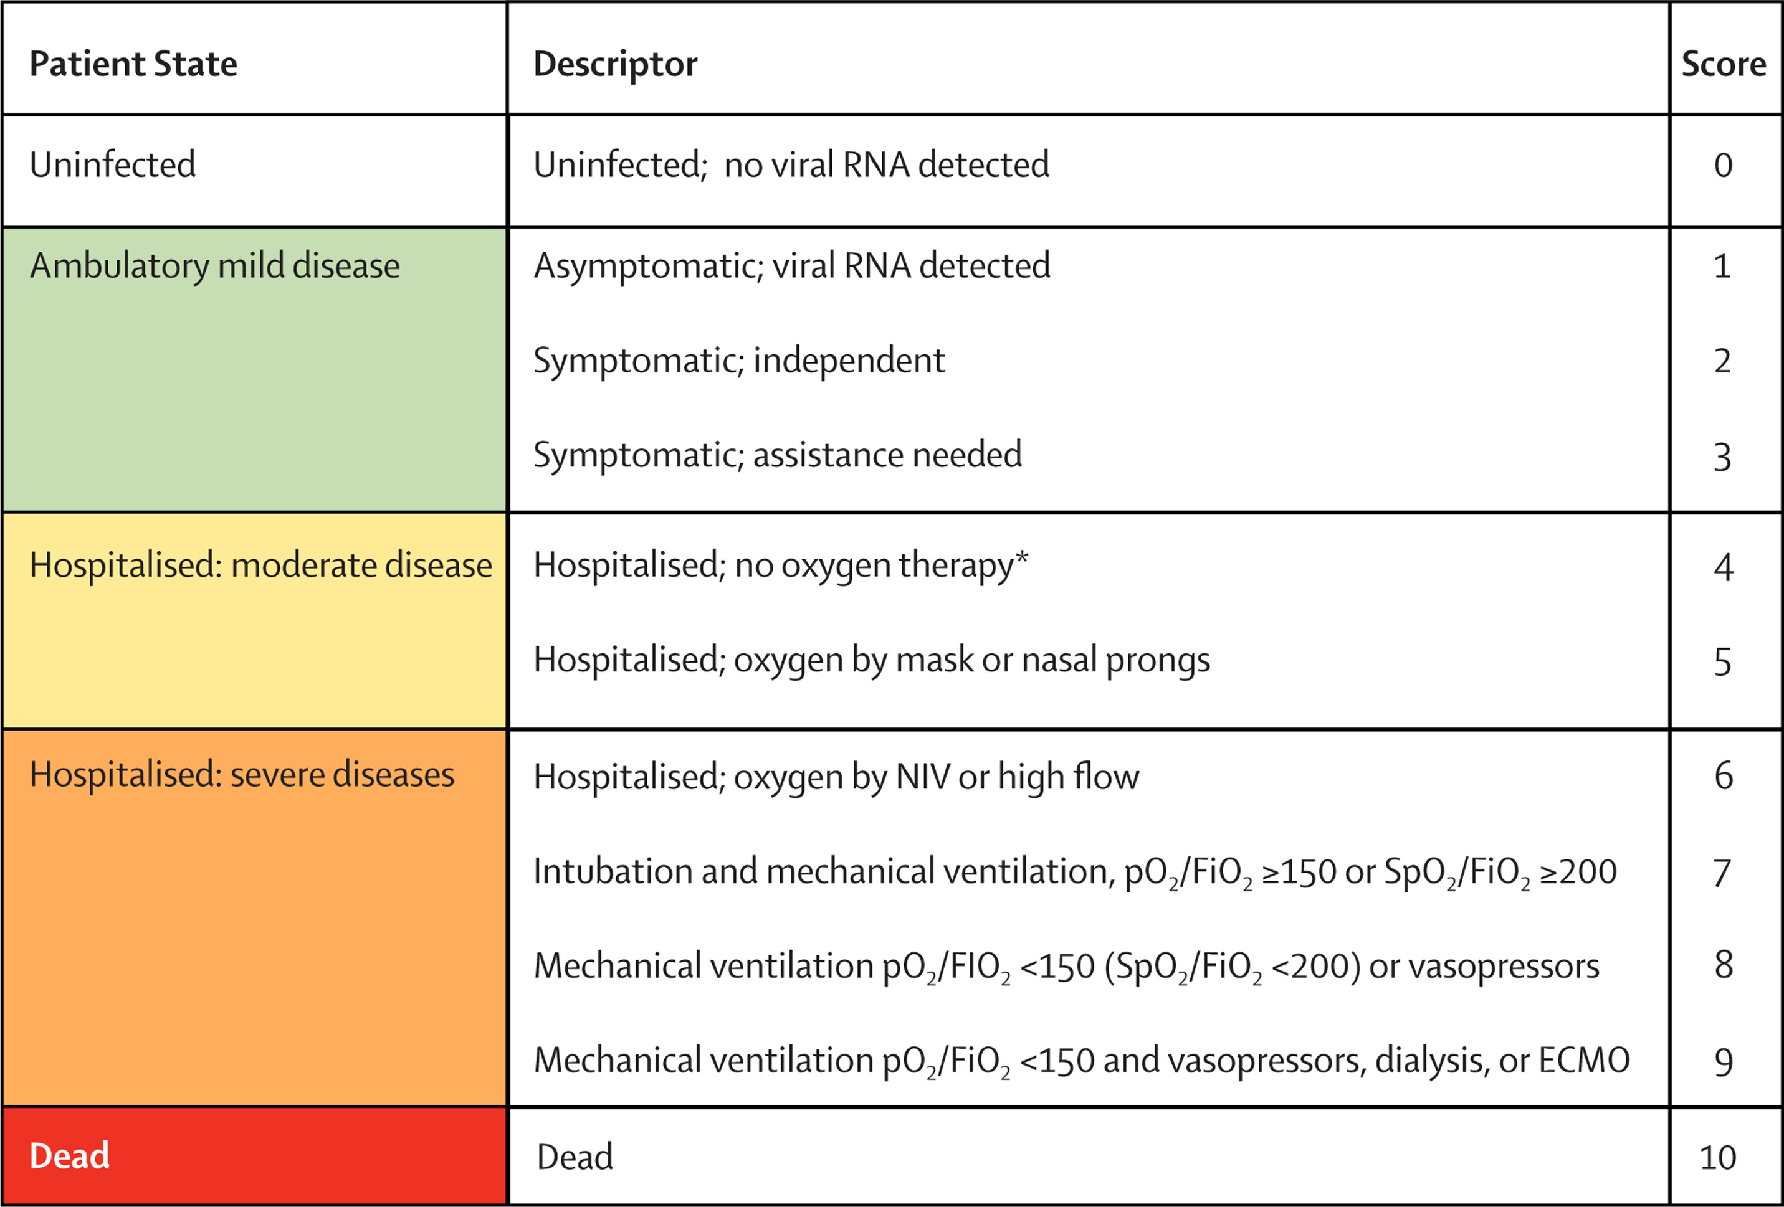
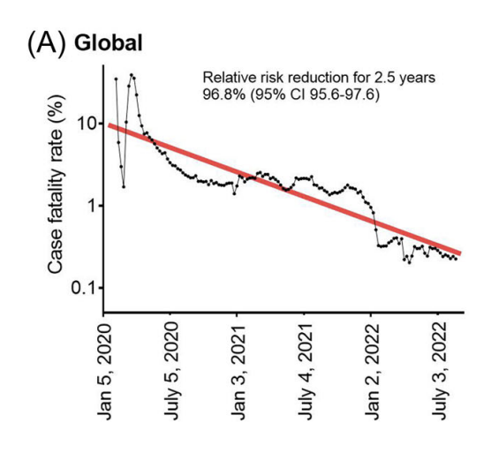
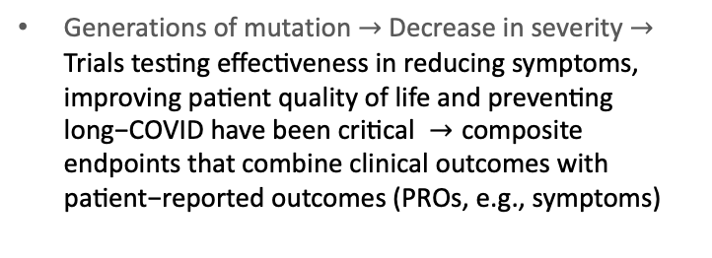
Section 1: Background - Trends in Use of Composite Endpoints in Clinical Trials
1.1 Introduction (Cont.)
Composite Endpoints Evolution Process – COVID-19 (DRAFT)
The evolution of composite endpoints for COVID-19 appears to follow a very similar pattern, though over a much shorter course.
The Lancet Infectious Diseases 2020 20e192-e197
DOI: (10.1016/S1473-3099(20)30483-7)
Generations of mutation $→$ Decrease in severity $→\text{Trials} \text{testing} \text{effectiveness} \text{in} \text{reducing} \text{symptoms}\text{, }\text{improving} \text{patient} \text{quality} \text{of} \text{life} \text{and} \text{preventing} \text{long}\text{−}\text{COVID} \text{have} \text{been} \text{critical} →\text{composite} \text{endpoints} \text{that} \text{combine} \text{clinical} \text{outcomes} \text{with} \text{patient}\text{−}\text{reported} \text{outcomes}\text{ (}\text{PROs}\text{, }\text{e}\text{.}\text{g}\text{., }\text{symptoms}\text{)}$
Severe COVID, composite endpoints focused on mortality and serious clinical events
2019-2020
2020-2023+
2020
WHO guidance: COVID-19 ordinal scale [17][20]
Horita and Fukumoto (2023)
Notes:
This is a world problem so WHO take rapid action.
Figure source: Global case fatality rate from COVID‐19 has decreased by 96.8% during 2.5 years of the pandemic: figure
[2]Califf RM, Harrelson-Woodlief L, Topol EJ. Left ventricular ejection fraction may not be useful as an end point of thrombolytic therapy comparative trials. Circulation American Heart Association, 1990; 82(5): 1847–1853.
[3]Braunwald E, Cannon CP, McCabe CH. Use of composite endpoints in thrombolysis trials of acute myocardial infarction. The American Journal of Cardiology 1993; 72(19): G3–G12.
[4]Ferreira-González I, Busse JW, Heels-Ansdell D, et al. Problems with use of composite end points in cardiovascular trials: systematic review of randomised controlled trials. BMJ (Clinical research ed.) 2007; 334(7597): 786.
[5]Hussain A, Misra A, Bozkurt B. Endpoints in Heart Failure Drug Development. Cardiac Failure Review 2022; 8: e01.
half of cardiovascular trials have adopted a composite endpoint inclusive of morbidity and mortality
Present the paper: 15 min, following the JAMA slides of collaboration 2 class.
One sentence summary/conclusion: the difference between covid and AHF in terms of use of ordinal outcome is for covid there is a strong voice like WHO and other association to put out some guidance.
Information about the evolution cannot be shown through our result, so need to show our literatures. (list key messages in our introduction)
The difference in the evolution
Why the use of composite endpoint is promoted so quickly.
Evolution of endpoints
Side by side (two diseases)
Provide context

Slide 7
Section 1: Background - Trends in Use of Composite Endpoints in Clinical Trials
1.1 Introduction (Cont.)
Observation:
Evolution from a solely emphasis on clinical events to a multi-dimensional evaluation incorporating PROs
Goals:
We conducted a literature review to
Describe and compare the trends of the use of composite endpoints in AHF and COVID-19 clinical trials quantitatively
Shed light on the need for further evolution of outcomes as well as the potential for composite outcomes in other areas.
Notes:
This is a world problem so WHO take rapid action.
Figure source: Global case fatality rate from COVID‐19 has decreased by 96.8% during 2.5 years of the pandemic: figure
[2]Califf RM, Harrelson-Woodlief L, Topol EJ. Left ventricular ejection fraction may not be useful as an end point of thrombolytic therapy comparative trials. Circulation American Heart Association, 1990; 82(5): 1847–1853.
[3]Braunwald E, Cannon CP, McCabe CH. Use of composite endpoints in thrombolysis trials of acute myocardial infarction. The American Journal of Cardiology 1993; 72(19): G3–G12.
[4]Ferreira-González I, Busse JW, Heels-Ansdell D, et al. Problems with use of composite end points in cardiovascular trials: systematic review of randomised controlled trials. BMJ (Clinical research ed.) 2007; 334(7597): 786.
[5]Hussain A, Misra A, Bozkurt B. Endpoints in Heart Failure Drug Development. Cardiac Failure Review 2022; 8: e01.
half of cardiovascular trials have adopted a composite endpoint inclusive of morbidity and mortality
Present the paper: 15 min, following the JAMA slides of collaboration 2 class.
One sentence summary/conclusion: the difference between covid and AHF in terms of use of ordinal outcome is for covid there is a strong voice like WHO and other association to put out some guidance.
Information about the evolution cannot be shown through our result, so need to show our literatures. (list key messages in our introduction)
The difference in the evolution
Why the use of composite endpoint is promoted so quickly.
Evolution of endpoints
Side by side (two diseases)
Provide context

Slide 8
Section 1: Background - Trends in Use of Composite Endpoints in Clinical Trials
1.2 Methods
1.2.1 Literature Search Strategy
PubMed (May 4, 2023)
Identification: clinical trials, composite endpoints, and disease types
Clinical trials: checkbox “Clinical Trials”
AHF and COVID-19 clinical trials using composite endpoints:
Within titles and abstracts
(“composite endpoint” OR “composite” OR “multiple endpoint” OR “ordinal” OR “-free” OR “win ratio” OR “global ranking”)
AND (“acute heart failure” OR “COVID- 19”).
Extra terms: “ordinal”, “-free”, “win ratio” and “global ranking”
Supplementary search
“clinical trials” within all text
All-disease type search
Notes:
Myocardial Infarction
Simplified this slide.
PubMed - final search was conducted on May 4, 2023
3-fold identification - clinical trials, composite endpoints, and disease types
Clinical trials: the checkbox “Clinical Trials” in the PubMed filter of article types.
AHF and COVID-19 clinical trials using composite endpoints:
titles and abstracts were searched for terms implying the use of composite endpoints (“composite endpoint” OR “composite” OR “multiple endpoint” OR “ordinal” OR “-free” OR “win ratio” OR “global ranking”) AND terms indicating disease types (“acute heart failure” OR “COVID- 19”).
Extra terms “ordinal”, “-free” (e.g., hospital-free or ventilator-free days), “win ratio” and “global ranking” supplementary search
were added to not miss studies using composite endpoints but not explicitly stating that the endpoint was a composite.
To avoid missing clinical trial papers not marked as “Clinical Trials” in PubMed and to capture AHF papers not specifically mentioning “acute heart failure”, a supplementary search was conducted not using the “Clinical Trials” checkbox but including “clinical trial” and removing disease types in the keyword search.
Data analysis can be mostly omitted

Slide 9
Section 1: Background - Trends in Use of Composite Endpoints in Clinical Trials
1.2 Methods
1.2.2 Annotation Strategy
Annotated by two authors (Liu and Shi) independently, recording
Exclusion reason (Inclusion criteria: if presenting primary results evaluating efficacy from AHF or COVID-19 clinical trials with at least one composite endpoint as either the primary or secondary outcome)
Year of publication,
Number of composite endpoints,
Statistical type (time-to-event, binary, ordinal, count, continuous, or mixed),
Composition type (clinical only, PROs only, or mixed),
Number of components in the primary composite endpoint.
Annotations were then compared and reconciled.
Notes:
Data analysis can be mostly omitted
Papers were considered eligible if they were presenting primary results evaluating efficacy from AHF or COVID-19 clinical trials with at least one composite endpoint as either the primary or secondary outcome.
statistical type mixed mainly denotes the use of win ratio and global ranking approaches

Slide 10
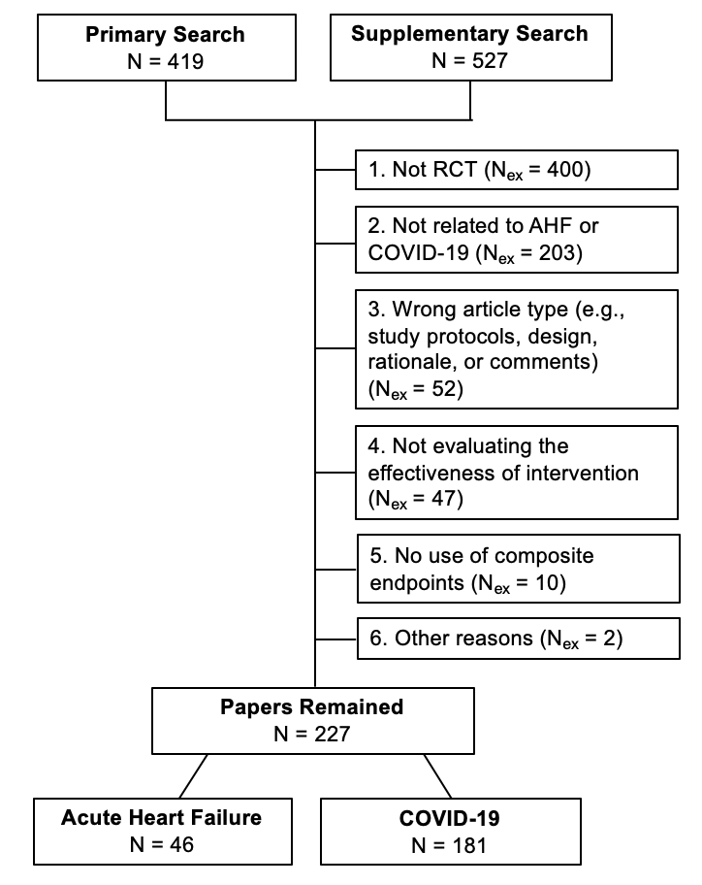
Section 1: Background - Trends in Use of Composite Endpoints in Clinical Trials
1.3 Results
Figure 1. Flow diagram for the inclusion/exclusion of clinical trial publications in our study.
Notes:
There are 946 publications in total with 419 from the primary search and 527 from the supplementary search. The 6 exclusion reasons are listed in a hierarchical order, with 1>2>...>6. That is, if a paper is neither RCT (reason 1) nor related to AHF or COVID-19 (reason 2), it will be classified as "1. Not RCT". The number of papers excluded due to a specific reason is denoted as "N_{ex}" presented in the parentheses. In the end, 227 papers met inclusion criteria with 46 from AHF trials and 181 from COVID-19 trials.

Slide 11
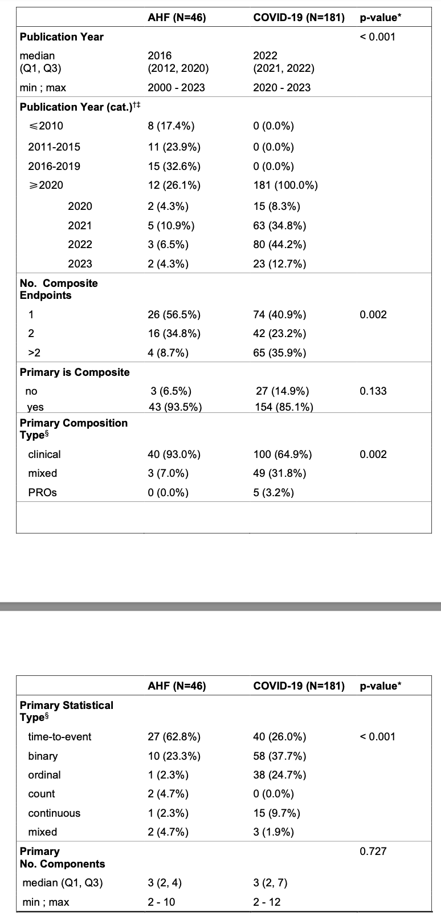
Section 1: Background - Trends in Use of Composite Endpoints in Clinical Trials
1.3 Results (Cont.)
Table 1. Descriptive statistics of the use of composite endpoints in AHF and COVID-19 trials
Results
COVID-19 trials were more likely to include multiple composite endpoints than AHF trials
COVID-19 trials were more likely to include PROs in the primary composite endpoints
AHF trials predominantly used time-to-event composite endpoints whereas COVID-19 trials were much more likely to use ordinal composite endpoints with more diversity in statistical types
Notes:
Table 1 screenshot and resize to fit in this slide
* The p-values are based on the Wilcoxon Rank Sum test for continuous variables and Pearson’s Chi-squared test for categorical variables.
† For continuous variable "Publication Year", categorized variables was derived as "Publication Year (cat.)" to provide more detailed information about the distribution. Note, this additional categorical variable would not be used for hypothesis testing.
‡ The categories of publication years of AHF trials ware derived based on quartiles; while for COVID-19, all eligible papers were published in or after 2020, so the number of trials for each year of 2020-2023 was listed.
§ For proportions related to the attributes of primary composite endpoints, the denominators are the total numbers of papers with primary endpoints being composite, which were summarized in "Primary is Composite - Yes".

Slide 12
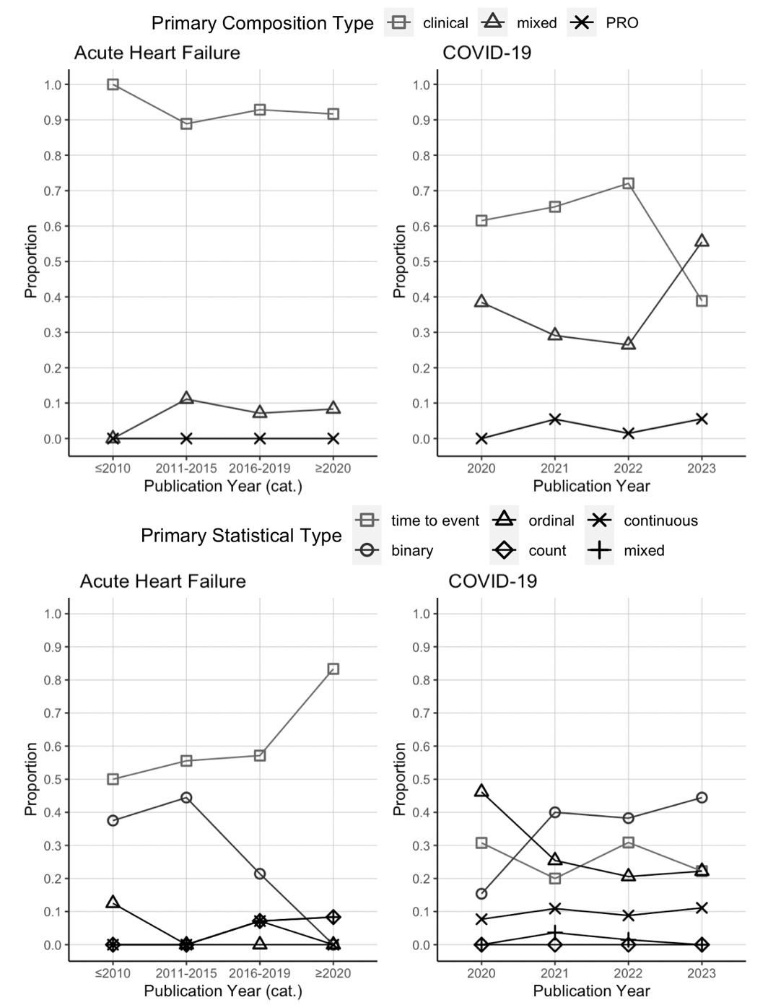
Section 1: Background - Trends in Use of Composite Endpoints in Clinical Trials
1.3 Results (Cont.)
(a)
(b)
Figure 2. Distribution of (a) composition type and (b) statistical type of the primary composite endpoints summarized over publication years for AHF trials (≤2010, 2011-2015, 2016-2019 and ≥2020) and COVID-19 trials (2020-2023).
Notes:
Overall Conclusion in words.
One sentence summary from paper
Mention in words.
Conclusion from discussion session of paper.

Slide 13
Section 1: Background - Trends in Use of Composite Endpoints in Clinical Trials
1.4 Discussion & Conclusion
Among trials where the primary outcome is a composite endpoint, COVID-19 trials were more likely to include PROs and use ordinal composite endpoints than AHF trials.
It is critical to understand the current stage of disease management when picking endpoints (fatal/treatable)
The well-recognized benefits of using composite endpoints are accompanied by challenges in their use
Ordinal composite endpoints can be difficult to interpret
Win ratio/global ranking are rarely used since clinical effect sizes are difficult to extract
The role of global consensus
Notes:
This is a world problem so WHO take rapid action.
Figure source: Global case fatality rate from COVID‐19 has decreased by 96.8% during 2.5 years of the pandemic: figure
[2]Califf RM, Harrelson-Woodlief L, Topol EJ. Left ventricular ejection fraction may not be useful as an end point of thrombolytic therapy comparative trials. Circulation American Heart Association, 1990; 82(5): 1847–1853.
[3]Braunwald E, Cannon CP, McCabe CH. Use of composite endpoints in thrombolysis trials of acute myocardial infarction. The American Journal of Cardiology 1993; 72(19): G3–G12.
[4]Ferreira-González I, Busse JW, Heels-Ansdell D, et al. Problems with use of composite end points in cardiovascular trials: systematic review of randomised controlled trials. BMJ (Clinical research ed.) 2007; 334(7597): 786.
[5]Hussain A, Misra A, Bozkurt B. Endpoints in Heart Failure Drug Development. Cardiac Failure Review 2022; 8: e01.
half of cardiovascular trials have adopted a composite endpoint inclusive of morbidity and mortality
Present the paper: 15 min, following the JAMA slides of collaboration 2 class.
One sentence summary/conclusion: the difference between covid and AHF in terms of use of ordinal outcome is for covid there is a strong voice like WHO and other association to put out some guidance.
Information about the evolution cannot be shown through our result, so need to show our literatures. (list key messages in our introduction)
The difference in the evolution
Why the use of composite endpoint is promoted so quickly.
Evolution of endpoints
Side by side (two diseases)
Provide context

Slide 14
Section 2: Simulation Study Understand the Power of Composite Endpoints related to Components
Notes:
Based on what we see, there is uptake of use of composite outcome
Most AHF still use survival, so in the simulation we also focus on the survival

Slide 15
Section 2: Simulation Study - Understand the Power of Composite Endpoints related to Components
2.1 Goals and Rationales
Goals: To understand the power of different ways of defining time-to-first, and ordinal/binary composite endpoints.
Composite VS Components
Different prevalence and effect sizes of individual components
Different approaches of combining components into composite
Rationales
There is an uptake of use of composite outcome
Specifically, most AHF still use time-to-first-event composites, while there is a more frequent use of ordinal and binary composite endpoints in COVID-19 trials
Notes:
Understanding the power of different ways of defining survival and ordinal composite endpoints.

Slide 16
Section 2: Simulation Study - Understand the Power of Composite Endpoints related to Components
2.2 Simulation Structure
Layer 0. Simulate single outcome, i.e., components
3 survival components (death included)
6 binary components
Layer 1. Combining same type of components
Time-to-event composite:
Combine 3 survival components into time-to-first event;
Binary composite:
Combine 6 binary components into yes/no if any of those happen.
Ordinal composites:
Sum up the 6 binary components
Order the 6 binary components by severity with a prespecified rank
Notes:
Layer 0. Simulate single outcome, i.e., components
3 survival components (death included)
6 binary components
Layer 1. Combining same type of components
Survival composite:
combining 3 survival components into time-to-first event;
Binary composite:
combining 6 binaries into yes/no if any of those happen.
Ordinal composite
sum up, no order in binary component.
ordered by severity with a prespecified rank, e.g., assuming binary component 1 is the most severe one, two is less severe, etc.)

Slide 17
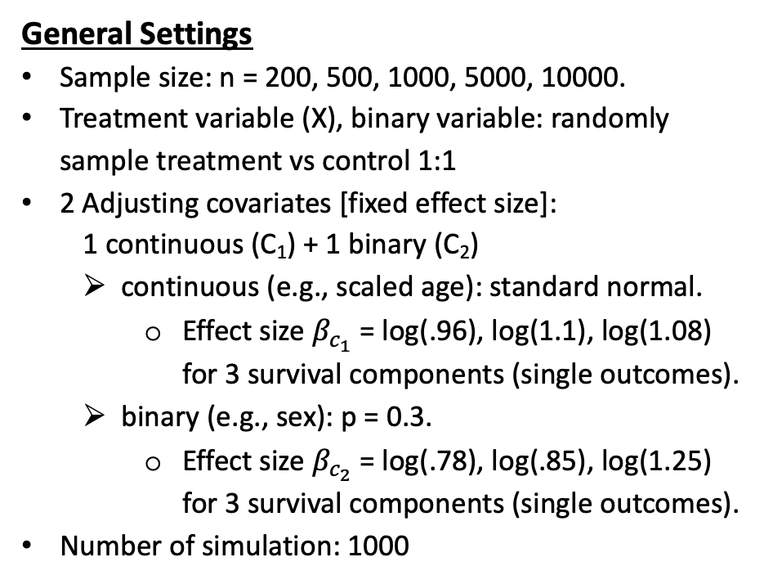
Section 2: Simulation Study - Understand the Power of Composite Endpoints related to Components
2.2.1 Survival Components & Time-to-First Composite
2.2.1.1 Set Up
General Settings
Sample size: n = 200, 500, 1000, 5000, 10000.
Treatment variable (X), binary variable: randomly sample treatment vs control 1:1
2 Adjusting covariates [fixed effect size]:
1 continuous (C₁) + 1 binary (C₂)
continuous (e.g., scaled age): standard normal.
Effect size ${\text{β}}_{c_{1}}$ = log(.96), log(1.1), log(1.08) for 3 survival components (single outcomes).
binary (e.g., sex): p = 0.3.
Effect size ${\text{β}}_{c_{2}}$ = log(.78), log(.85), log(1.25) for 3 survival components (single outcomes).
Number of simulation: 1000
Scenarios
20 Scenarios, combined from:
5 different treatment effect sizes (HR, 𝛽_{x}) for 3 components [first component mimics death]
log(1), log(1), log(1) (All HR are all 1)
log(1), log(0.8), log(0.8)
log(1), log(0.6), log(0.6)
log(1), log(0.8), log(0.6)
log(1), log(0.6), log(0.8)
4 different prevalence of 3 survival components [first component mimics death]
5%, 10%, 10%
5%, 10%, 20%
5%, 20%, 10%
5%, 20%, 20%
Notes:
Unified title line.
Know where we are regarding Section
Choice of adjusting covariates effect size is based on the fact that # most time binary covariates will have larger effect than continuous outcome. We just fixed the positive/negative effect, the numeric number is just a random small number.
beta_C: notations.

Slide 18
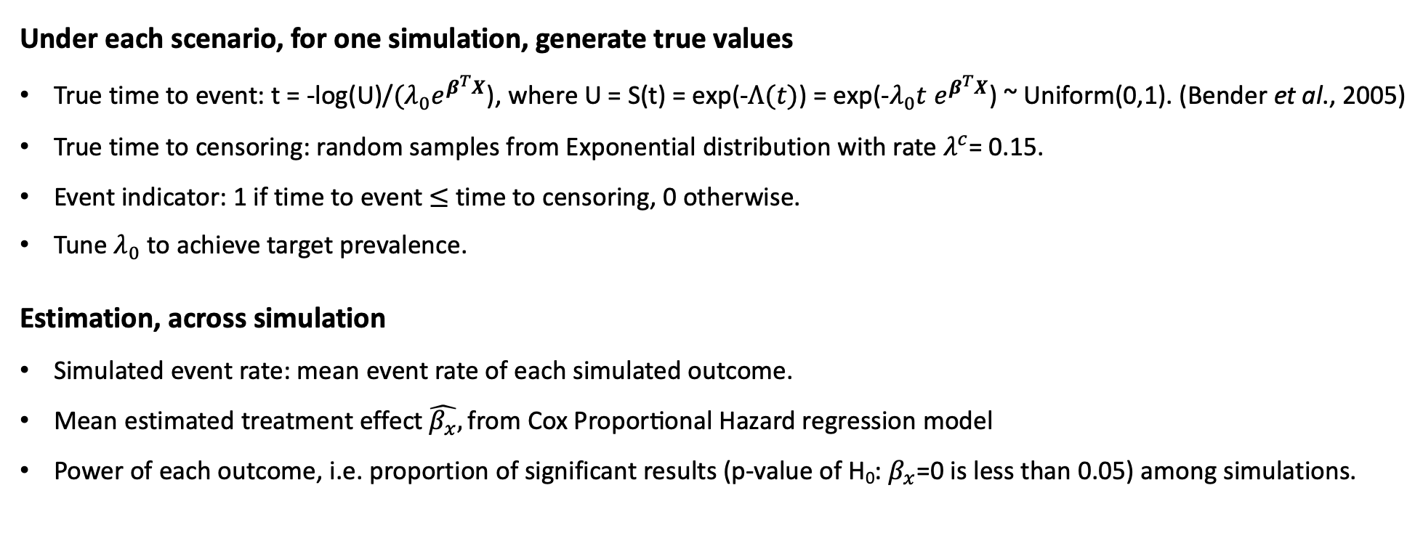
Section 2: Simulation Study - Understand the Power of Composite Endpoints related to Components
2.2.1 Survival Components & Time-to-First Composite
2.2.1.1 Set Up (Cont.)
Under each scenario, for one simulation, generate true values
True time to event: t = -log(U)/$(λ_{0}e^{β^{T}X}$), where U = S(t) = exp(-$Λ(t)$) = exp(-$λ_{0}t e^{β^{T}X}$) ~ Uniform(0,1). (Bender et al., 2005)
True time to censoring: random samples from Exponential distribution with rate $λ^{c}$= 0.15.
Event indicator: 1 if time to event $≤$ time to censoring, 0 otherwise.
Tune $λ_{0}$ to achieve target prevalence.
Estimation, across simulation
Simulated event rate: mean event rate of each simulated outcome.
Mean estimated treatment effect $\hat{β_{x}},\text{from} \text{Cox} \text{Proportional} \text{Hazard} \text{regression} \text{model}$
Power of each outcome, i.e. proportion of significant results (p-value of H₀: $β_{x}$=0 is less than 0.05) among simulations.
Notes:
Estimation By fitting Cox regression proportional hazard model
Choice of adjusting covariates effect size is based on the fact that # most time binary covariates will have larger effect than continuous outcome. We just fixed the positive/negative effect, the numeric number is just a random small number.
# generate X and covariates, these should be different across simulations, and vary across ns, but same for 3 outcomes.

Slide 19
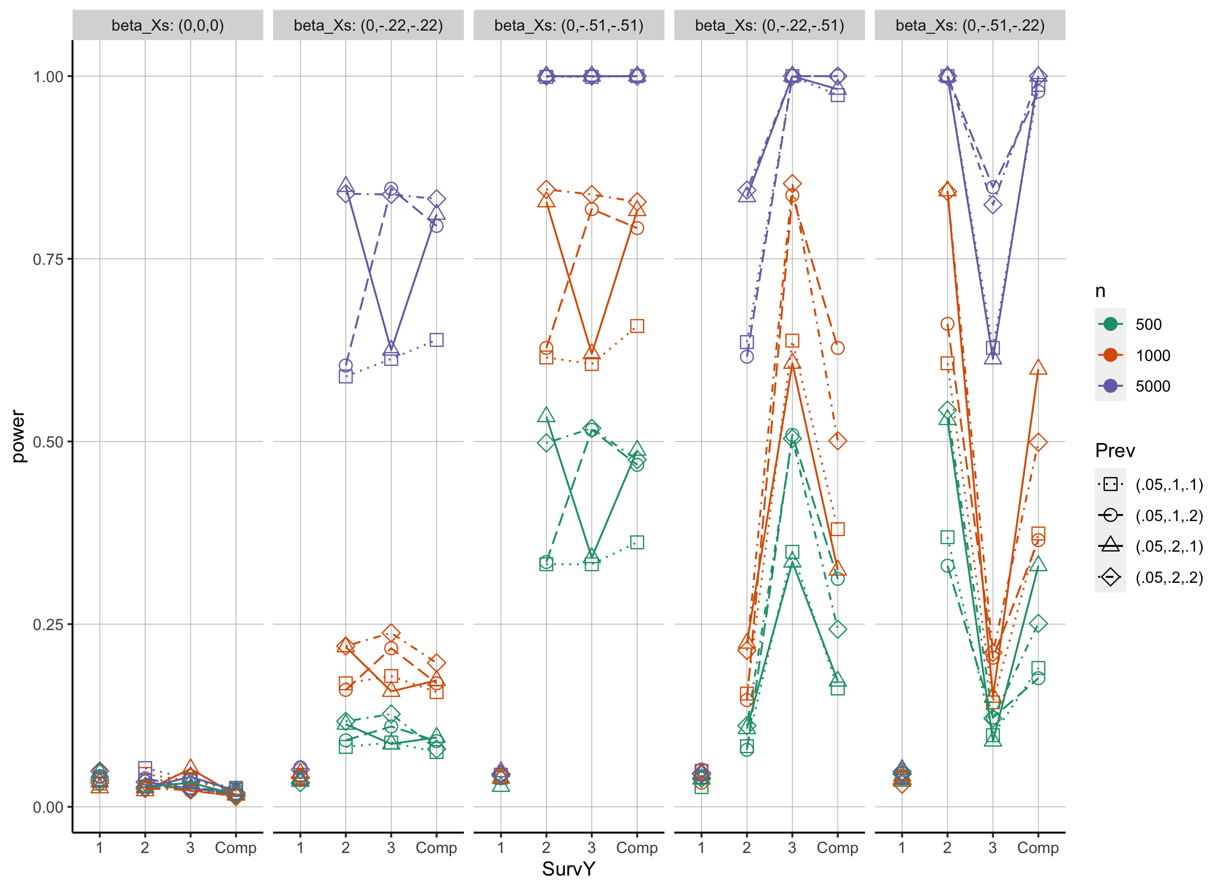
Section 2: Simulation Study - Understand the Power of Composite Endpoints related to Components
2.2.1 Survival Components & Time-to-First Composite
2.2.1.2 Simulation Result
log(0.8) = -0.22,
log(0.6) = -0.51
Results
Composite VS Components, not gives the best power in most cases (94/100).
When two single outcomes have same prevalence of 0.1 and same non-zero treatment effect, the use of composite outcome increases the power.
Notes:
Need to let clinician know:
Here we evaluate power, but doesn’t mean power is not everything one needs to consider when you design a trial
We talked about benefits of composite endpoints, including multiple information into 1.
In this case, survival composite endpoint is defined as time to the first, it might be how it was defined resulting in what we observed.
Result also depends on the way of defining the CE.
If there is a better way to utilize survival components
This is actually in our literature review (Introduction, find this), there is limitation of only using time to first, and how to overcome this limitation
Here we defined this way since it is most intuitive
MAKE sure don’t overstate what we observed in the simulation.
Refine the figure texts later.
The composite time to first outcome, compared to the best individual outcome, not gives the best power in most cases.
In some special cases, where two single outcomes have same prevalence (0.1, represented by squares) and same non-zero treatment effect, the use of composite outcome increases the power.
Conclusion: the use of composite outcome includes more information (doubles event rate), however the corresponding effect size is diluted by individual outcome with no effect, which results in loss of power.
> topPower %>% filter(SurvY=='Composite') %>% as.data.frame
SurvY n power mean_event_rate mean_est_coef prevalence beta_X beta_C1 beta_C2 lamb0
1 Composite 5000 0.639 0.2224296 -0.1381521 NA <NA> NA NA NA
2 Composite 10000 0.942 0.2221163 -0.1418098 NA <NA> NA NA NA
3 Composite 500 0.362 0.2182100 -0.3245931 NA <NA> NA NA NA
4 Composite 1000 0.658 0.2184050 -0.3188363 NA <NA> NA NA NA
5 Composite 5000 1.000 0.2183340 -0.3231650 NA <NA> NA NA NA
6 Composite 10000 0.993 0.3571323 -0.1286721 NA <NA> NA NA NA
exp_rate scenario idx_beta_X idx_prev grp_idx beta_Xs Prev
1 NA 2 2 1 9 (0,-.22,-.22) (.05,.1,.1)
2 NA 2 2 1 10 (0,-.22,-.22) (.05,.1,.1)
3 NA 3 3 1 12 (0,-.51,-.51) (.05,.1,.1)
4 NA 3 3 1 13 (0,-.51,-.51) (.05,.1,.1)
5 NA 3 3 1 14 (0,-.51,-.51) (.05,.1,.1)
6 NA 17 2 4 85 (0,-.22,-.22) (.05,.2,.2)
Simplified the words
Frame to highlight
As sample size increases, power increases.
Outcome 1 with no effect always has the lowest power, except for the case where all beta_X’s being 0.
We know that higher event rate and larger effect size will increase power. Which can be seen from:
1. Same effect size: For outcomes with same non-zero betas (penal 2 and 3), from the pattern of circles and triangles of outcome 2 and 3. circles always go upwards, triangle always go downwards.
Same prevalence: squares and rhombus in panel 4 and 5

Slide 20
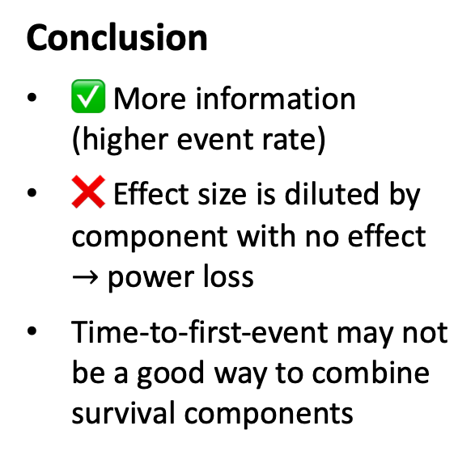
Section 2: Simulation Study - Understand the Power of Composite Endpoints related to Components
2.2.1 Survival Components & Time-to-First Composite
2.2.1.2 Simulation Result (Cont.)
Prevalence ([0,1]) and effect size (log hazard ratio) of survival composite (empirical)
Effect Sizes: (0, -0.22, -0.22)
n | Component Prevalence | Composite Prevalence | Composite Effect Size
500 | (.05,0.1,0.1) | 0.2221 | -0.1414
 | (.05,0.1,0.2) | 0.2919 | -0.1395
 | (.05,0.2,0.1) | 0.2951 | -0.1415
 | (.05,0.2,0.2) | 0.3573 | -0.1347
1000 | (.05,0.1,0.1) | 0.2226 | -0.1473
 | (.05,0.1,0.2) | 0.2917 | -0.1348
 | (.05,0.2,0.1) | 0.2940 | -0.1357
 | (.05,0.2,0.2) | 0.3574 | -0.1334
5000 | (.05,0.1,0.1) | 0.2224 | -0.1382
 | (.05,0.1,0.2) | 0.2918 | -0.1396
 | (.05,0.2,0.1) | 0.2942 | -0.1384
 | (.05,0.2,0.2) | 0.3573 | -0.1297
Effect Sizes: (0, -0.51, -0.51)
n | Component Prevalence | Composite Prevalence | Composite Effect Size
500 | (.05,0.1,0.1) | 0.2182 | -0.3246
 | (.05,0.1,0.2) | 0.2916 | -0.3155
 | (.05,0.2,0.1) | 0.2896 | -0.3230
 | (.05,0.2,0.2) | 0.3544 | -0.2892
1000 | (.05,0.1,0.1) | 0.2184 | -0.3188
 | (.05,0.1,0.2) | 0.2915 | -0.3102
 | (.05,0.2,0.1) | 0.2896 | -0.3202
 | (.05,0.2,0.2) | 0.3535 | -0.3006
5000 | (.05,0.1,0.1) | 0.2183 | -0.3232
 | (.05,0.1,0.2) | 0.2911 | -0.3133
 | (.05,0.2,0.1) | 0.2895 | -0.3135
 | (.05,0.2,0.2) | 0.3534 | -0.2993
Conclusion
✅ More information (higher event rate)
❌ Effect size is diluted by component with no effect $→$ power loss
Time-to-first-event may not be a good way to combine survival components
Notes:
-0.22. is log(0.8), -0.51 is log(0.6)
Conclusion: the use of composite outcome includes more information (doubles event rate), however the corresponding effect size is diluted by individual outcome with no treatment effect, which results in loss of power.
As sample size increases, power increases.
Outcome 1 with no effect always has the lowest power, except for the case where all beta_X’s being 0.
We know that higher event rate and larger effect size will increase power. Which can be seen from:
1. Same effect size: For outcomes with same non-zero betas (penal 2 and 3), from the pattern of circles and triangles of outcome 2 and 3. circles always go upwards, triangle always go downwards.
Same prevalence: squares and rhombus in panel 4 and 5

Slide 21
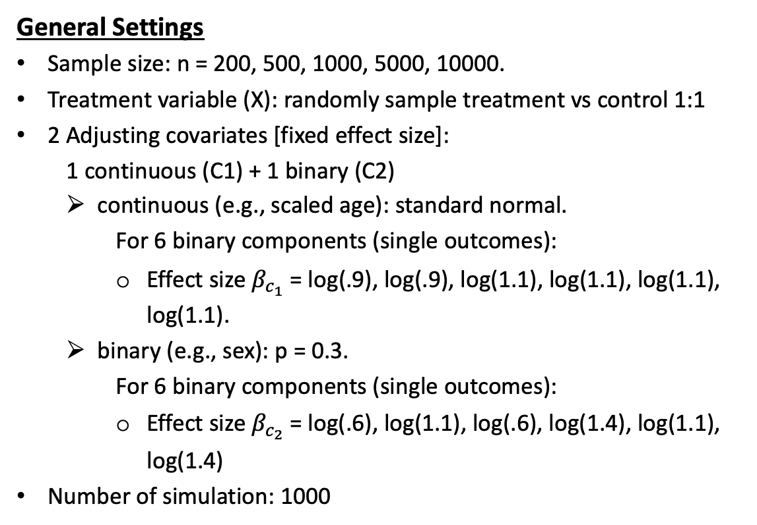
Section 2: Simulation Study - Understand the Power of Composite Endpoints related to Components
2.2.2 Binary Components & Binary/Ordinal Composite
2.2.2.1 Set Up
General Settings
Sample size: n = 200, 500, 1000, 5000, 10000.
Treatment variable (X): randomly sample treatment vs control 1:1
2 Adjusting covariates [fixed effect size]:
1 continuous (C1) + 1 binary (C2)
continuous (e.g., scaled age): standard normal.
For 6 binary components (single outcomes):
Effect size ${\text{β}}_{c_{1}}$ = log(.9), log(.9), log(1.1), log(1.1), log(1.1), log(1.1).
binary (e.g., sex): p = 0.3.
For 6 binary components (single outcomes):
Effect size ${\text{β}}_{c_{2}}$= log(.6), log(1.1), log(.6), log(1.4), log(1.1), log(1.4)
Number of simulation: 1000
6 Binary Components
Prevalence
binary 1 - binary 6
10%, 20%, 10%, 20%, 10%, 20%.
Treatment effect: have no, small, medium (, or large) effect for different binary single outcomes.
1,2: no treatment effect: log(1)
3,4: small treatment effect: log(0.8)
5,6: medium treatment effect: log(0.6)
Notes:
Simulate MVN
Focus on ordinal
After simulate this data, we can derive the distribution of ordinal composite outcome that can be used for power calculation

Slide 22
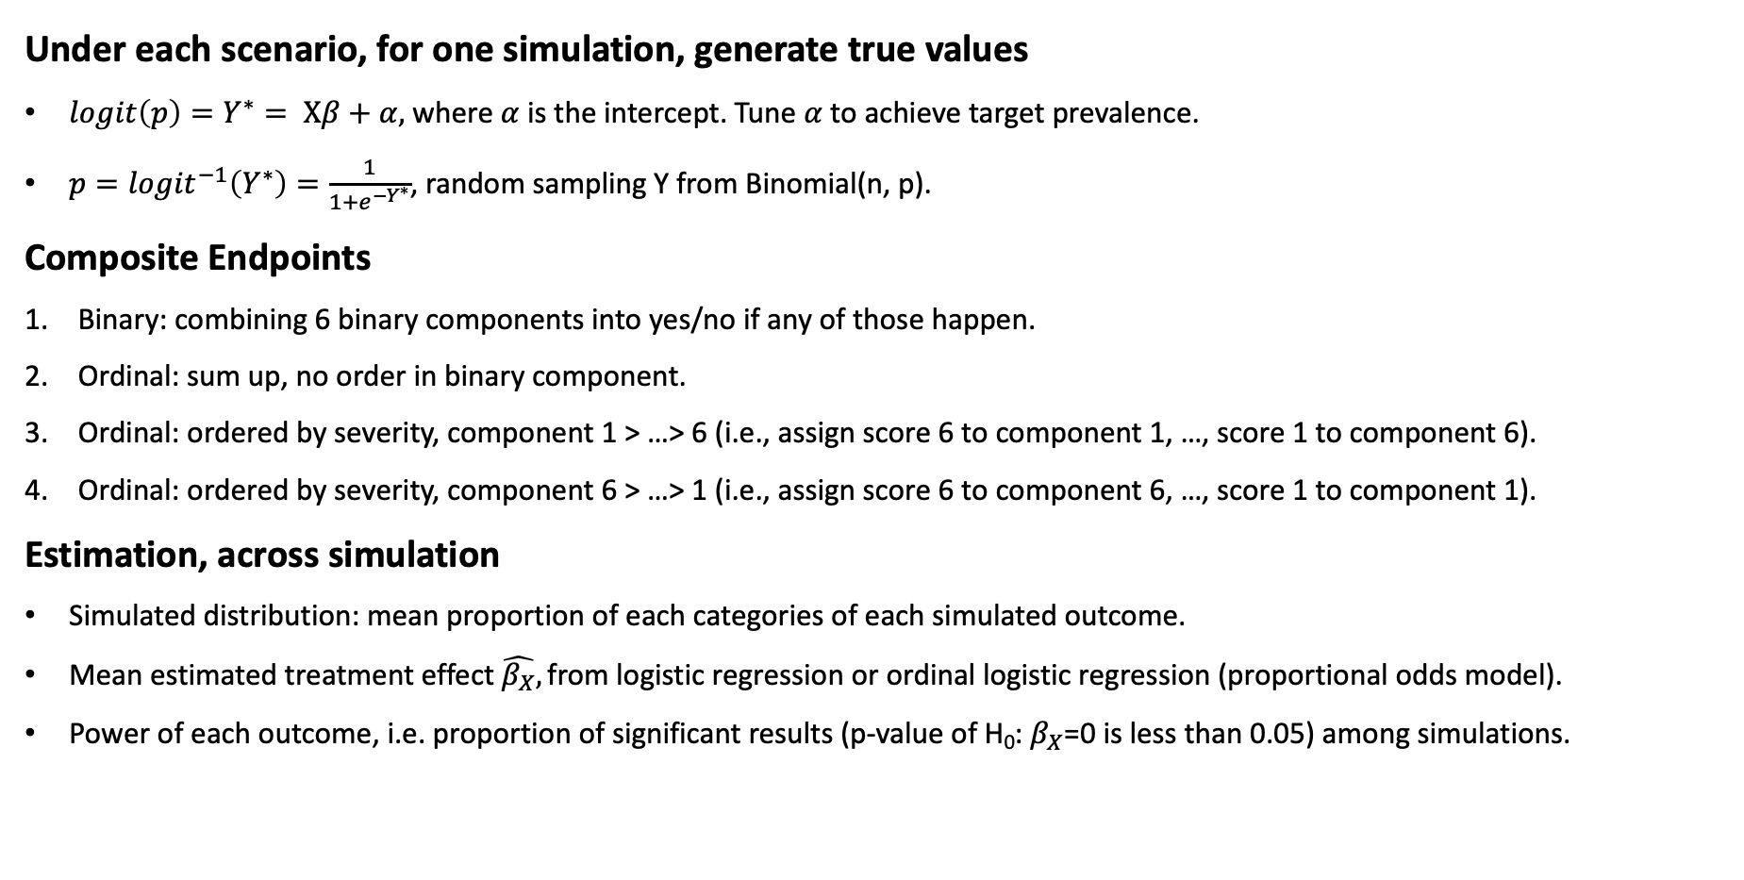
Section 2: Simulation Study - Understand the Power of Composite Endpoints related to Components
2.2.2 Binary Components & Binary/Ordinal Composite
2.2.2.1 Set Up (Cont.)
Under each scenario, for one simulation, generate true values
${logit\left(p\right)=Y}^{∗}= Xβ+α,$ where $α$ is the intercept. Tune $α$to achieve target prevalence.
$p={logit}^{−1}\left(Y^{∗}\right)=\frac{1}{1+e^{−Y^{∗}}}$, random sampling Y from Binomial(n, p).
Composite Endpoints
Binary: combining 6 binary components into yes/no if any of those happen.
Ordinal: sum up, no order in binary component.
Ordinal: ordered by severity, component 1 > …> 6 (i.e., assign score 6 to component 1, …, score 1 to component 6).
Ordinal: ordered by severity, component 6 > …> 1 (i.e., assign score 6 to component 6, …, score 1 to component 1).
Estimation, across simulation
Simulated distribution: mean proportion of each categories of each simulated outcome.
Mean estimated treatment effect $\hat{β_{X}},\text{from}$logistic regression or ordinal logistic regression (proportional odds model).
Power of each outcome, i.e. proportion of significant results (p-value of H₀: $β_{X}$=0 is less than 0.05) among simulations.
Notes:
Choice of adjusting covariates effect size is based on the fact that # most time binary covariates will have larger effect than continuous outcome. We just fixed the positive/negative effect, the numeric number is just a random small number.
# generate X and covariates, these should be different across simulations, and vary across ns, but same for 3 outcomes.

Slide 23
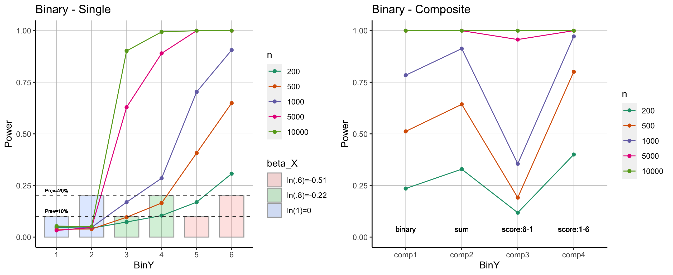
Section 2: Simulation Study - Understand the Power of Composite Endpoints related to Components
2.2.2 Binary Components & Binary/Ordinal Composite
2.2.2.2 Simulation Result
Notes:
For single binary outcome, larger effect size and higher prevalence lead to greater power.
For composite endpoints, the best power is achieved by comp4 – Ordinal composite outcome, ordered by severity, from 1 to 6, while the worst power is from comp3 - Ordinal composite outcome, ordered by severity, from 6 to 1. Comp1 (single binary indicator)’s power is between outcome 5 and 6, while comp2 (ordinal, total number of events) seems slightly better than the best single outcome 6. All results follows our expectation.

Slide 24
Section 2: Simulation Study - Understand the Power of Composite Endpoints related to Components
2.2.2 Binary Components & Binary/Ordinal Composite
2.2.2.2 Simulation Result (Cont.)
Proportion of categories ([0,1]) and effect size (log odds ratio) of binary/ordinal composite (empirical)
Prevalence: (10%, 20%, 10%, 20%, 10%, 20%); Effect sizes: (0, 0, -0.22, -0.22, -0.51, -0.51)
n | Composite | Scale 0 | Scale 1 | Scale 2 | Scale 3 | Scale 4 | Scale 5 | Scale 6 | Composite Effect Size | Composite Power
500 | Binary | 0.3685 | 0.6315 | \ | \ | \ | \ | \ | -0.3666 | 0.514
 | Ordinal - Sum | 0.3685 | 0.4027 | 0.1808 | 0.0423 | 0.0053 | 0.0003 | 0.0000 | -0.3930 | 0.646
 | Ordinal - Order1 | 0.3685 | 0.0953 | 0.0568 | 0.1292 | 0.0696 | 0.1836 | 0.0970 | -0.1793 | 0.201
 | Ordinal - Order2 | 0.3685 | 0.0398 | 0.1047 | 0.0546 | 0.1373 | 0.0855 | 0.2095 | -0.4557 | 0.806
1000 | Binary | 0.3677 | 0.6323 | \ | \ | \ | \ | \ | -0.3591 | 0.774
 | Ordinal - Sum | 0.3677 | 0.4041 | 0.1803 | 0.0422 | 0.0053 | 0.0003 | 0.0000 | -0.3899 | 0.915
 | Ordinal - Order1 | 0.3677 | 0.0963 | 0.0565 | 0.1289 | 0.0695 | 0.1832 | 0.0979 | -0.1797 | 0.35
 | Ordinal - Order2 | 0.3677 | 0.0404 | 0.1045 | 0.0549 | 0.1380 | 0.0852 | 0.2094 | -0.4429 | 0.97
5000 | Binary | 0.3677 | 0.6323 | \ | \ | \ | \ | \ | -0.3597 | 1
 | Ordinal - Sum | 0.3677 | 0.4038 | 0.1806 | 0.0422 | 0.0053 | 0.0004 | 0.0000 | -0.3901 | 1
 | Ordinal - Order1 | 0.3677 | 0.0961 | 0.0564 | 0.1297 | 0.0694 | 0.1832 | 0.0974 | -0.1820 | 0.952
 | Ordinal - Order2 | 0.3677 | 0.0403 | 0.1044 | 0.0547 | 0.1380 | 0.0850 | 0.2099 | -0.4444 | 1
Notes:
Combination of effect size and prevalence.
NOTE: here category 0-6 is not equivalent to component
Hard to explain the detailed effects.
We can only ZZ an intuition is that order 1 give higher score to 1,3,5 or say prioritize 1,3,5 compared to 2,4,6,
While order 2 give higher score to 246.
And since component 1,3,5 has much lower prevalence than 2,4,6. This makes the power of ordinal – order 1 smaller.
e.g. category 0 for all composite are cases when component 1-6 are all 0
Category 1 for binary is when any of component is 1
Category 1 for ordinal-sum is when one of component is 1
Category 1 for ordinal-order1 is when component 6 is 1
Category 1 for ordinal-order2 is when component 1 is 1
As sample size increases, power increases.
Outcome 1 with no effect always has the lowest power, except for the case where all beta X’s being 0.
We know that higher event rate and larger effect size will increase power. Which can be seen from:
1. Same effect size: For outcomes with same non-zero betas (penal 2 and 3), from the pattern of circles and triangles of outcome 2 and 3. circles always go upwards, triangle always go downwards.
Same prevalence: squares and rhombus in panel 4 and 5

Slide 25
Section 3: Plan for Paper 1 Power Consideration of Ordinal Composite Endpoints
Notes:
From the simulation, we verified the prevalence/treatment effect sizes/and the way of combining components play a role and indeed affect the power of composite endpoints. So now we want to delve deeper into the power definition, where we started with finding the theoretical form for the power of the ordinal variable. The existing methods including this whitehead paper, which requests we know the proportion of the categories of ordinal variable. This proportion of components can either be found through simulation, or can be derived through some theoretical form. That is, we need to find the joint distribution of the binary components, and derive the proportion of categories based on how the components are combined
Dandan: based on the simulation results, we know the power varied by how composite outcome are derived. Then I’m curious to explore power calculation of ordinal composite endpoint. In the existing literature, what are available, which is the wh paper: have the ordinal outcome, don’t care about how it was built, here is the power given .
This wh paper is not always applicable since we don’t know the distribution (we don’t have the data). This limitation motivates me to the rest of the work.

Slide 26
Section 3: Plan for Paper 1 - Power Consideration of Ordinal Composite Endpoints
3.1 Existing Methods and Limitations
3.1.1 Power of Ordinal Variable
Whitehead J. Sample size calculations for ordered categorical data. Stat Med. 1993 Dec 30;12(24):2257-71. doi: 10.1002/sim.4780122404. Erratum in: Stat Med 1994 Apr 30;13(8):871. PMID: 8134732.
Assumptions
Proportional odds
Normal approximation (accurate for moderate to large sample size)
Requirements
Know the distribution (that is, the proportion of patients who will fall into each category of response) of the ordinal variable
Notes:
There are plenty of work of statistical consideration on time-to-event and binary composites
Ordinal composites are increasingly adopted in clinical trials but little has been written regarding the statistical consideration of ordinal composites.
This is a major formula people use to calculate the power of ordinal variables.
And also is what Frank use in his package.
Power of ordinal variable
Whitehead J. Sample size calculations for ordered categorical data. Stat Med. 1993 Dec 30;12(24):2257-71. doi: 10.1002/sim.4780122404. Erratum in: Stat Med 1994 Apr 30;13(8):871. PMID: 8134732.
Requires knowing the distribution (that is the proportion of patients who will fall into each category of response) of the ordinal variable
Solution 1: estimate by simulation, i.e., empirical distribution
Solution 2: find theoretical formula to calculate the distribution of ordinal composite based on distribution of individual components. (say: in reality data around individual component is more likely to be available; solution 2 is our direction)
Timeline:
Oral: 12/12
Two weeks ahead for sharing materials
Manuscript for JCTS
Ordinal composite outcome
Start with simulation result
Start working on the draft.
Derive theoretical form to improve current power calculation
Rerun simulation by introducing correlation.
Show current analytical form assuming independence is biased
Plan of application on Treatnow.
Results from application
Plan for next meeting
Treatnow data what can be used.
Manuscript: Formula derivation
For a specific copula
Formula for ordinal composite

Slide 27
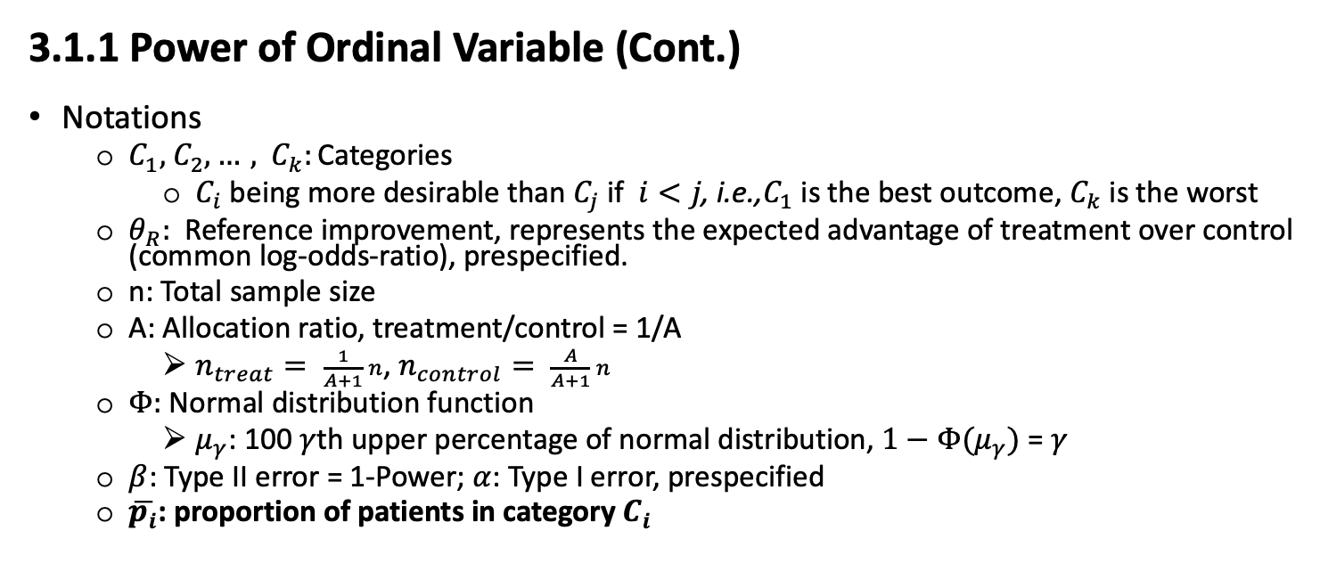

Section 3: Plan for Paper 1 - Power Consideration of Ordinal Composite Endpoints
3.1 Existing Methods and Limitations
3.1.1 Power of Ordinal Variable (Cont.)
Notations
$C_{1},$ $C_{2},…,$ $C_{k}:\text{Categori}\text{es}$
$C_{i} \text{being} \text{more} \text{desirable} \text{than} C_{j} \text{if} i<j\text{, }\text{i}\text{.}\text{e}\text{.,}C_{1} \text{is} \text{the} \text{best} \text{outcome}\text{, }C_{k} \text{is} \text{the} \text{worst}$
$θ_{R}:$Reference improvement, represents the expected advantage of treatment over control (common log-odds-ratio), prespecified.
n: Total sample size
A: Allocation ratio, treatment/control = 1/A
$n_{treat}= \frac{1}{A+1} n$, $n_{control}= \frac{A}{A+1} n$
$Φ:$Normal distribution function
$μ_{γ}$: 100 $γ$th upper percentage of normal distribution, $1−Φ(μ_{γ})$ = $γ$
$β$: Type II error = 1-Power; $α$: Type I error, prespecified
$\overline{p_{i}}$: proportion of patients in category $C_{i}$
$Power= 1−β=$ $Φ(μ_{β})=$ $Φ(θ_{R}\sqrt{\frac{An^{3}}{3({n+1)}^{2}(A+{1)}^{2}}(1−\sum_{i}{{\overline{p_{i}}}^{3}})} − μ_{\frac{α}{2}} )$
Notes:
Keep the slides
Don’t read it
Pick 1 or 2 to explain if reused in the slides: e.g. can explain pi bar.
This is a major formula people use to calculate the power of ordinal variables when the distribution of ordinal variable is known (existing knowledge)
And also is what Frank use in his package.
Timeline:
Oral: 12/12
Two weeks ahead for sharing materials
Manuscript for JCTS
Ordinal composite outcome
Start with simulation result
Start working on the draft.
Derive theoretical form to improve current power calculation
Rerun simulation by introducing correlation.
Show current analytical form assuming independence is biased
Plan of application on Treatnow.
Results from application
Plan for next meeting
Treatnow data what can be used.
Manuscript: Formula derivation
For a specific copula
Formula for ordinal composite

Slide 28
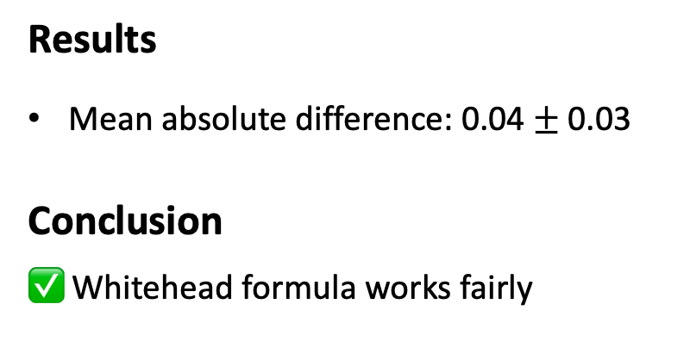
3.1.2 Empirical Ordinal Composite Power - Simulation vs Whitehead Formula
Section 3: Plan for Paper 1 - Power Consideration of Ordinal Composite Endpoints
3.1 Existing Methods and Limitations
n | Composite | Power | Average Power - WH | Absolute Difference
500 | Ordinal - Sum | 0.646 | 0.613 | 0.033
 | Ordinal - Order1 | 0.201 | 0.278 | 0.077
 | Ordinal - Order2 | 0.806 | 0.730 | 0.076
1000 | Ordinal - Sum | 0.915 | 0.831 | 0.084
 | Ordinal - Order1 | 0.35 | 0.397 | 0.047
 | Ordinal - Order2 | 0.97 | 0.915 | 0.055
5000 | Ordinal - Sum | 1 | 1 | 0
 | Ordinal - Order1 | 0.952 | 0.877 | 0.075
 | Ordinal - Order2 | 1 | 1 | 0
Results
Mean absolute difference: 0.04 $±$ 0.03
Conclusion
✅ Whitehead formula works fairly
Notes:
Table from ordinal_composite_summ.csv
During simulations, we’re trying to see if there is existing formula to calculate power. => wh, (more details in section 3) requires knowing distribution of ordinal composite outcome, although we know the marginal distribution of binary components, we don’t have formula to derive the joint distribution (composite). So we have to use empirical approaches to obtain the distribution of composite endpoint and show the result here.
Because of this, we were motivated to think about: if I’m able to derive the formula to calculate the distribution of composite endpoint given marginal distribution of binary component, then we can directly use the whitehead approach.
(we confirm wh is working although there might be some discrepancy due to the use of empirical distribution of )
Later after finished paper1, added a another column with my approach to within each simulation use my approach to calculate distribution of ordinal composite and use wh to calculate power. To show if it’s really works.
Empirical distribution then wh formula
Last slide of section 2.
Details of wh in section 3.
Probably need a slide for wh paper. If have time.

Slide 29
Section 3: Plan for Paper 1 - Power Consideration of Ordinal Composite Endpoints
3.1 Existing Methods and Limitations
3.1.3 Distribution Derivation for Ordinal Composites
Methods for Ordinal Composite defined as the Sum of Binary Variables
Woodward, J. Arthur, and Christina GS Palmer. "On the exact convolution of discrete random variables." Applied Mathematics and Computation 83.1 (1997): 69-77.
(Assumption: Independence, while success probabilities can be different)
George, E. Olusegun, and Dale Bowman. "A full likelihood procedure for analysing exchangeable binary data." Biometrics (1995): 512-523.
(Assumption: Exchangeability, i.e., common success probability and common correlation)
Witt, Gary. "A simple distribution for the sum of correlated, exchangeable binary data." Communications in Statistics-Theory and Methods 43.20 (2014): 4265-4280.
(Assumption: Exchangeability)
Methods for Ordinal Composite defined as the Ordered Binary Variables
No existing literatures
Notes:
This is important!!!!!!!!!! Familiar with each paper.
Timeline:
Oral: 12/12
Two weeks ahead for sharing materials
Manuscript for JCTS
Ordinal composite outcome
Start with simulation result
Start working on the draft.
Derive theoretical form to improve current power calculation
Rerun simulation by introducing correlation.
Show current analytical form assuming independence is biased
Plan of application on Treatnow.
Results from application
Plan for next meeting
Treatnow data what can be used.
Manuscript: Formula derivation
For a specific copula
Formula for ordinal composite

Slide 30
Section 3: Plan for Paper 1 - Power Consideration of Ordinal Composite Endpoints
3.1 Existing Methods and Limitations
3.1.4 Summary of Limitations
Methods | Utility | Major Limitation
Whitehead 1993 | Power Formula for Ordinal Variable | Requires knowing the distribution of the ordinal variable; Proportional odds assumption; Normal approximation
Woodward 1997 | Distribution of the Sum of Binary Variables | Assumption: Independence
George 1995 | Distribution of the Sum of Binary Variables | Assumption: Exchangeability
Witt 2014 | Distribution of the Sum of Binary Variables | Assumption: Exchangeability
\ | Distribution of the Ordered Binary Variables | No existing work
Our solution: find other way to obtain the distribution of the ordinal composite and use whitehead formula to get power.
Notes:
This is important!!!!!!!!!! Familiar with each paper.
Timeline:
Oral: 12/12
Two weeks ahead for sharing materials
Manuscript for JCTS
Ordinal composite outcome
Start with simulation result
Start working on the draft.
Derive theoretical form to improve current power calculation
Rerun simulation by introducing correlation.
Show current analytical form assuming independence is biased
Plan of application on Treatnow.
Results from application
Plan for next meeting
Treatnow data what can be used.
Manuscript: Formula derivation
For a specific copula
Formula for ordinal composite

Slide 31
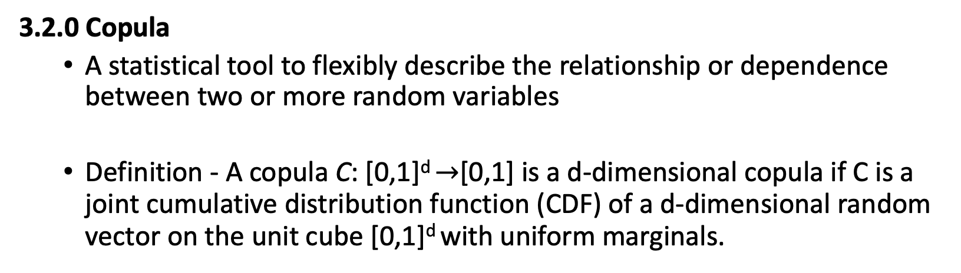
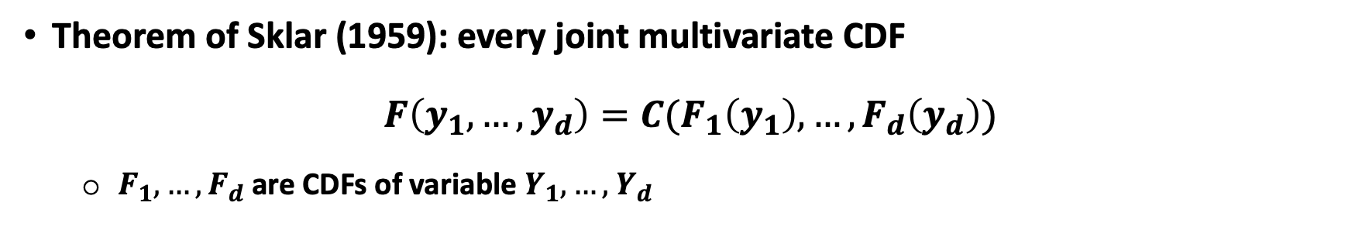
Section 3: Plan for Paper 1 - Power Consideration of Ordinal Composite Endpoints
3.2 Proposed Work Based on Joint Distribution of the Binary Components
3.2.0 Copula
A statistical tool to flexibly describe the relationship or dependence between two or more random variables
Definition - A copula C: [0,1]^{d} $→$[0,1] is a d-dimensional copula if C is a joint cumulative distribution function (CDF) of a d-dimensional random vector on the unit cube [0,1]^{d} with uniform marginals.
Theorem of Sklar (1959): every joint multivariate CDF
$$F\left(y_{1},…,y_{d}\right)=C(F_{1}\left(y_{1}\right),…,F_{d}\left(y_{d}\right))$$
$F_{1},…, F_{d}$ are CDFs of variable $Y_{1},…,$ $Y_{d}$
Notes:
GIVE SIMPLE EXPLAINATION OF COPULA: MAPPING HIGHER DIMENSION TO ONE DIMENTSION
CONNECTED WITH OUR CASE: IT IS THE DIFINITION OF COMPOSITE ENDPOINT USING COMPONENTS JOINT DISTRIBUTION OF MULTIPLE BINARY VARIABLES => AN SMARTART WITH SEVERAL COMPONENTS POINTING INTO A COMPOSITE.
Definition - A bivariate copula C: [0,1]² $→$[0,1] is a function which is a bivariate cumulative distribution function with uniform marginals.
A copula is a statistical tool used in probability theory and statistics to describe the relationship or dependence between two or more random variables. The key idea behind copulas is to separate the marginal behavior of each variable (how each variable behaves on its own) from their dependence structure (how they interact with each other).
The fundamental theorem for copulas, known as Sklar's Theorem, states that any multivariate joint distribution can be expressed in terms of its marginal distributions and a copula which captures the dependence structure between the variables. This allows for great flexibility in modeling complex relationships, as you can choose marginals that best fit each variable and a copula that best captures their interaction.
Copulas are widely used in various fields such as finance, insurance, hydrology, and engineering, particularly for risk management and portfolio optimization, as they can model tail dependencies and other complex interactions between risks.
Solution 2: find theoretical form for the joint distribution of the components and derive the proportion of each category of the ordinal variable based on different ways of combining the components.
Timeline:
Oral: 12/12
Two weeks ahead for sharing materials
Manuscript for JCTS
Ordinal composite outcome
Start with simulation result
Start working on the draft.
Derive theoretical form to improve current power calculation
Rerun simulation by introducing correlation.
Show current analytical form assuming independence is biased
Plan of application on Treatnow.
Results from application
Plan for next meeting
Treatnow data what can be used.
Manuscript: Formula derivation
For a specific copula
Formula for ordinal composite

Slide 32
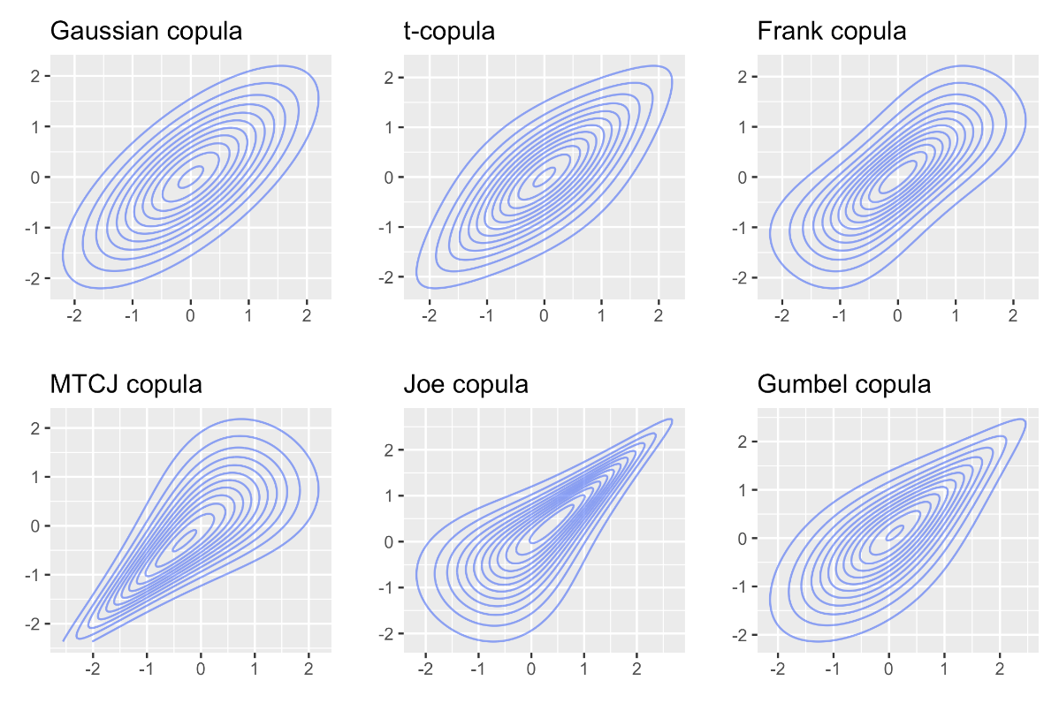
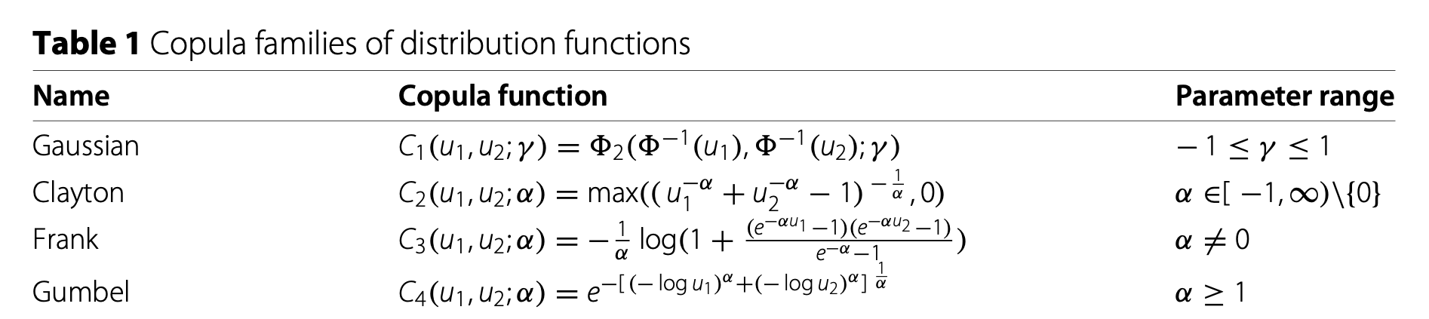
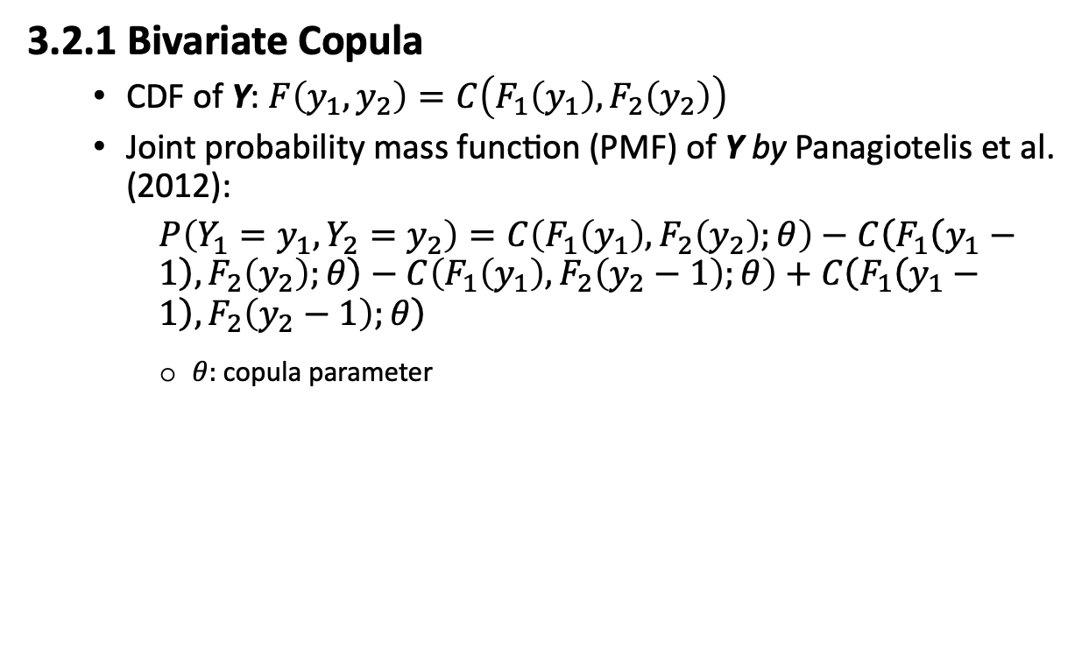
Section 3: Plan for Paper 1 - Power Consideration of Ordinal Composite Endpoints
3.2 Proposed Work Based on Joint Distribution of the Binary Components
3.2.1 Bivariate Copula
CDF of Y: $F\left(y_{1},y_{2}\right)=C\left(F_{1}\left(y_{1}\right),F_{2}\left(y_{2}\right)\right)$
Joint probability mass function (PMF) of Y by Panagiotelis et al. (2012):
$P\left(Y_{1}=y_{1},{Y_{2}=y}_{2}\right)=C\left(F_{1}\left(y_{1}\right),F_{2}\left(y_{2}\right);θ\right)−$ $C\left(F_{1}\left(y_{1}−1\right),F_{2}\left(y_{2}\right);θ\right)−$ $C\left(F_{1}\left(y_{1}\right),F_{2}\left(y_{2}−1\right);θ\right)+$ $C\left(F_{1}\left(y_{1}−1\right),F_{2}\left(y_{2}−1\right);θ\right)$
$θ:$copula parameter
(Bo, 2019)
(Lin& Chaganty, 2021)
Notes:
e.g., for the Gaussian copula, it is the correlation coefficient $γ$, and it is α for the Clayton, Frank, and Gumbel copulas. Can be calculated with known Corr($Y_{1}$, $Y_{2}$) and distributions of $Y_{1}$ and $Y_{2}$
GIVE SIMPLE EXPLAINATION OF COPULA: MAPPING HIGHER DIMENSION TO ONE DIMENTSION
CONNECTED WITH OUR CASE: IT IS THE DIFINITION OF COMPOSITE ENDPOINT USING COMPONENTS JOINT DISTRIBUTION OF MULTIPLE BINARY VARIABLES => AN SMARTART WITH SEVERAL COMPONENTS POINTING INTO A COMPOSITE.
A copula is a statistical tool used in probability theory and statistics to describe the relationship or dependence between two or more random variables. The key idea behind copulas is to separate the marginal behavior of each variable (how each variable behaves on its own) from their dependence structure (how they interact with each other).
The fundamental theorem for copulas, known as Sklar's Theorem, states that any multivariate joint distribution can be expressed in terms of its marginal distributions and a copula which captures the dependence structure between the variables. This allows for great flexibility in modeling complex relationships, as you can choose marginals that best fit each variable and a copula that best captures their interaction.
Copulas are widely used in various fields such as finance, insurance, hydrology, and engineering, particularly for risk management and portfolio optimization, as they can model tail dependencies and other complex interactions between risks.
Solution 2: find theoretical form for the joint distribution of the components and derive the proportion of each category of the ordinal variable based on different ways of combining the components.
Timeline:
Oral: 12/12
Two weeks ahead for sharing materials
Manuscript for JCTS
Ordinal composite outcome
Start with simulation result
Start working on the draft.
Derive theoretical form to improve current power calculation
Rerun simulation by introducing correlation.
Show current analytical form assuming independence is biased
Plan of application on Treatnow.
Results from application
Plan for next meeting
Treatnow data what can be used.
Manuscript: Formula derivation
For a specific copula
Formula for ordinal composite

Slide 33
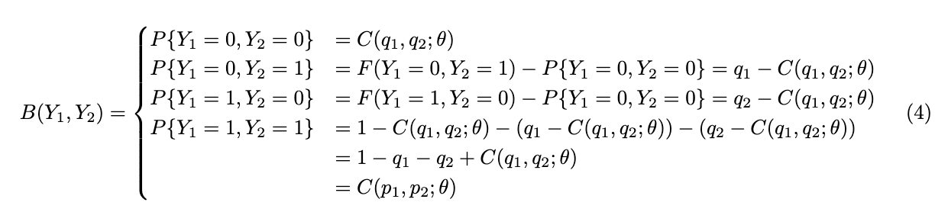
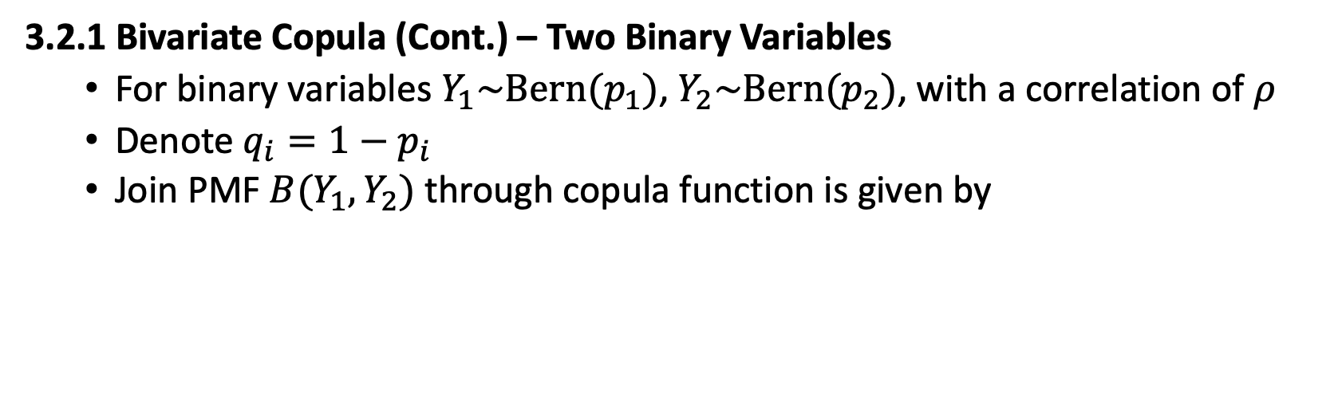

Section 3: Plan for Paper 1 - Power Consideration of Ordinal Composite Endpoints
3.2 Proposed Work Based on Joint Distribution of the Binary Components
3.2.1 Bivariate Copula (Cont.) – Two Binary Variables
For binary variables $Y_{1}\sim Bern(p_{1})$, $Y_{2}\sim Bern(p_{2})$, with a correlation of $ρ$
Denote $q_{i}=1−p_{i}$
Join PMF ${B(Y}_{1},Y_{2})$ through copula function is given by
Where $θ$ can be calculated by solving
Notes:
GIVE SIMPLE EXPLAINATION OF COPULA: MAPPING HIGHER DIMENSION TO ONE DIMENTSION
CONNECTED WITH OUR CASE: IT IS THE DIFINITION OF COMPOSITE ENDPOINT USING COMPONENTS JOINT DISTRIBUTION OF MULTIPLE BINARY VARIABLES => AN SMARTART WITH SEVERAL COMPONENTS POINTING INTO A COMPOSITE.
A copula is a statistical tool used in probability theory and statistics to describe the relationship or dependence between two or more random variables. The key idea behind copulas is to separate the marginal behavior of each variable (how each variable behaves on its own) from their dependence structure (how they interact with each other).
The fundamental theorem for copulas, known as Sklar's Theorem, states that any multivariate joint distribution can be expressed in terms of its marginal distributions and a copula which captures the dependence structure between the variables. This allows for great flexibility in modeling complex relationships, as you can choose marginals that best fit each variable and a copula that best captures their interaction.
Copulas are widely used in various fields such as finance, insurance, hydrology, and engineering, particularly for risk management and portfolio optimization, as they can model tail dependencies and other complex interactions between risks.
Solution 2: find theoretical form for the joint distribution of the components and derive the proportion of each category of the ordinal variable based on different ways of combining the components.
Timeline:
Oral: 12/12
Two weeks ahead for sharing materials
Manuscript for JCTS
Ordinal composite outcome
Start with simulation result
Start working on the draft.
Derive theoretical form to improve current power calculation
Rerun simulation by introducing correlation.
Show current analytical form assuming independence is biased
Plan of application on Treatnow.
Results from application
Plan for next meeting
Treatnow data what can be used.
Manuscript: Formula derivation
For a specific copula
Formula for ordinal composite

Slide 34
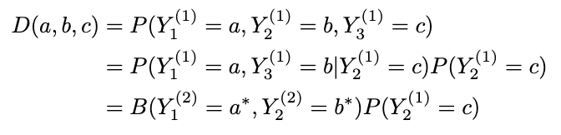
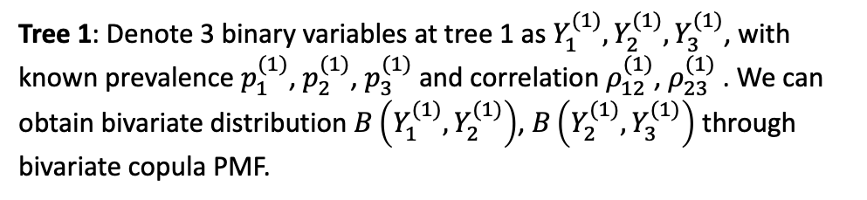
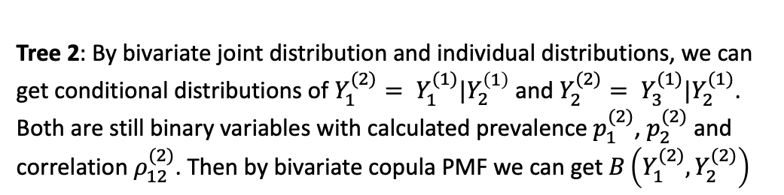
Section 3: Plan for Paper 1 - Power Consideration of Ordinal Composite Endpoints
3.2 Proposed Work Based on Joint Distribution of the Binary Components
3.2.2 Vine Copulas
The idea is that we decompose the high dimensional PMF into bivariate copulas (densities) and marginal densities.
Tree 1: Denote 3 binary variables at tree 1 as $Y_{1}^{(1)},Y_{2}^{(1)},Y_{3}^{(1)}$, with known prevalence $p_{1}^{(1)}$, $p_{2}^{(1)}$, $p_{3}^{(1)}$and correlation $ρ_{12}^{(1)}$, $ρ_{23}^{(1)}$. We can obtain bivariate distribution $B\left(Y_{1}^{(1)},Y_{2}^{(1)}\right)$, $B\left(Y_{2}^{(1)},Y_{3}^{(1)}\right)$ through bivariate copula PMF.
12
23
1
2
3
Tree 1
(1,3|2), i.e., (1|2 , 3|2)
Tree 2: By bivariate joint distribution and individual distributions, we can get conditional distributions of $Y_{1}^{(2)}= Y_{1}^{(1)}|Y_{2}^{\left(1\right)}$ and $Y_{2}^{(2)}= Y_{3}^{(1)}|Y_{2}^{(1)}$. Both are still binary variables with calculated prevalence $p_{1}^{(2)}$, $p_{2}^{(2)}$ and correlation $ρ_{12}^{(2)}$. Then by bivariate copula PMF we can get $B\left(Y_{1}^{(2)},Y_{2}^{(2)}\right)$
13|2
12
23
Tree 2
P(1,2,3) = P(1,3|2)P(2)
Then trivariate binary distribution (denoted by D) can be derived by Bayes theorem
Notes:
Vine Copula:
Vine copulas, or pair-copula constructions, are an extension of the basic copula concept. They offer a more flexible framework for modeling complex and high-dimensional dependence structures. The idea is to decompose a multivariate distribution into a cascade of bivariate copulas, which are easier to understand and estimate.
In vine copula models, the multivariate dependence structure is represented as a graphical model, which consists of a sequence of trees. Each tree captures different levels of interactions among the variables: the first tree captures direct dependencies between pairs of variables, and subsequent trees capture conditional dependencies given variables already linked in previous trees.
https://hudsonthames.org/a-practical-intro-to-vine-copula/
Solution 2: find theoretical form for the joint distribution of the components and derive the proportion of each category of the ordinal variable based on different ways of combining the components.
Timeline:
Oral: 12/12
Two weeks ahead for sharing materials
Manuscript for JCTS
Ordinal composite outcome
Start with simulation result
Start working on the draft.
Derive theoretical form to improve current power calculation
Rerun simulation by introducing correlation.
Show current analytical form assuming independence is biased
Plan of application on Treatnow.
Results from application
Plan for next meeting
Treatnow data what can be used.
Manuscript: Formula derivation
For a specific copula
Formula for ordinal composite

Slide 35
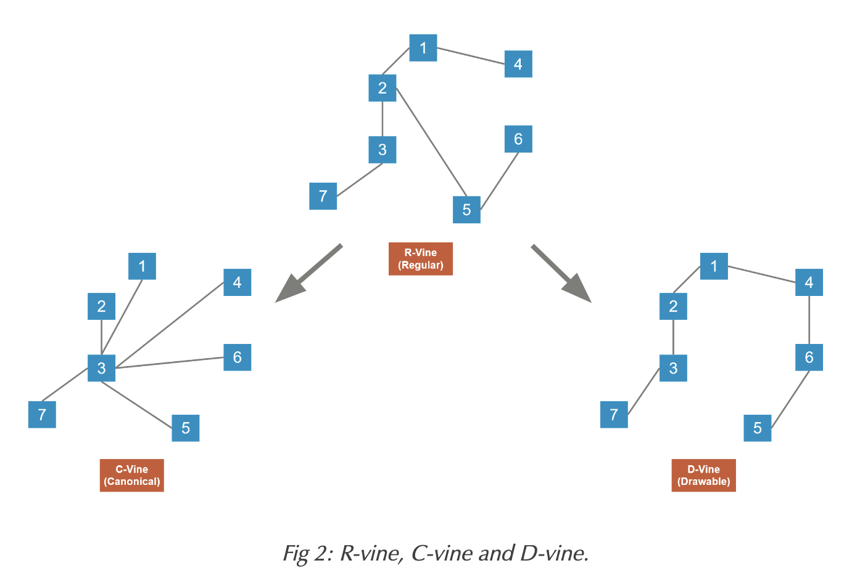
Section 3: Plan for Paper 1 - Power Consideration of Ordinal Composite Endpoints
3.2 Proposed Work Based on Joint Distribution of the Binary Components
3.2.2 Vine Copulas (Cont.)
Vine Copula Types
Regular Vine structure (R-vine): Each layer of the tree must have N-1 edges for N nodes, and all the nodes in this layer must be connected
Canonical Vine (C-vine): for every layer of the tree there is a center component.
Drawable Vine (D-vine): each tree is a path, i.e., there is one road that goes through all the nodes.
© Copyright - Hudson & Thames
Notes:
Vine Copula:
Vine copulas, or pair-copula constructions, are an extension of the basic copula concept. They offer a more flexible framework for modeling complex and high-dimensional dependence structures. The idea is to decompose a multivariate distribution into a cascade of bivariate copulas, which are easier to understand and estimate.
In vine copula models, the multivariate dependence structure is represented as a graphical model, which consists of a sequence of trees. Each tree captures different levels of interactions among the variables: the first tree captures direct dependencies between pairs of variables, and subsequent trees capture conditional dependencies given variables already linked in previous trees.
https://hudsonthames.org/a-practical-intro-to-vine-copula/
Solution 2: find theoretical form for the joint distribution of the components and derive the proportion of each category of the ordinal variable based on different ways of combining the components.
Timeline:
Oral: 12/12
Two weeks ahead for sharing materials
Manuscript for JCTS
Ordinal composite outcome
Start with simulation result
Start working on the draft.
Derive theoretical form to improve current power calculation
Rerun simulation by introducing correlation.
Show current analytical form assuming independence is biased
Plan of application on Treatnow.
Results from application
Plan for next meeting
Treatnow data what can be used.
Manuscript: Formula derivation
For a specific copula
Formula for ordinal composite

Slide 36
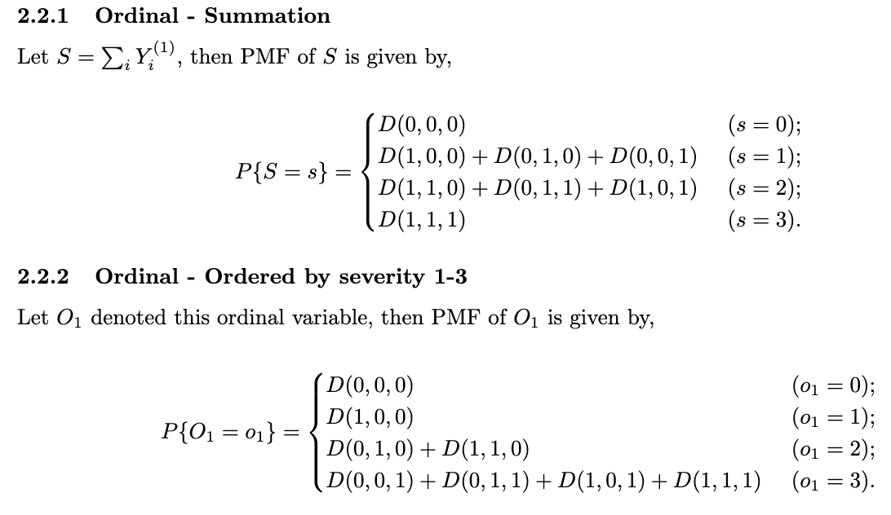
Section 3: Plan for Paper 1 - Power Consideration of Ordinal Composite Endpoints
3.2 Proposed Work Based on Joint Distribution of the Binary Components
3.2.3 Derive the Distribution of Ordinal Composite
After obtaining the multivariate distributions of correlated binary components generated by vine copulas, we can easily derive the distribution of the ordinal composite outcome based on how the components are combined.
E.g., for the trivariate case,
Ordinal - Summation:
Notes:
Panagiotelis, Anastasios, Claudia Czado, and Harry Joe. "Pair copula constructions for multivariate discrete data." Journal of the American Statistical Association 107.499 (2012): 1063-1072.
Brechmann, Eike Christian, and Ulf Schepsmeier. "Modeling dependence with C-and D-vine copulas: the R package CDVine." Journal of statistical software 52 (2013): 1-27.
Lin, Huihui, and Chaganty, N. Rao. "Multivariate distributions of correlated binary variables generated by pair-copulas." Journal of Statistical Distributions and Applications 8.1 (2021): 1-14.
Vine Copula:
Vine copulas, or pair-copula constructions, are an extension of the basic copula concept. They offer a more flexible framework for modeling complex and high-dimensional dependence structures. The idea is to decompose a multivariate distribution into a cascade of bivariate copulas, which are easier to understand and estimate.
In vine copula models, the multivariate dependence structure is represented as a graphical model, which consists of a sequence of trees. Each tree captures different levels of interactions among the variables: the first tree captures direct dependencies between pairs of variables, and subsequent trees capture conditional dependencies given variables already linked in previous trees.
https://hudsonthames.org/a-practical-intro-to-vine-copula/
Solution 2: find theoretical form for the joint distribution of the components and derive the proportion of each category of the ordinal variable based on different ways of combining the components.
Timeline:
Oral: 12/12
Two weeks ahead for sharing materials
Manuscript for JCTS
Ordinal composite outcome
Start with simulation result
Start working on the draft.
Derive theoretical form to improve current power calculation
Rerun simulation by introducing correlation.
Show current analytical form assuming independence is biased
Plan of application on Treatnow.
Results from application
Plan for next meeting
Treatnow data what can be used.
Manuscript: Formula derivation
For a specific copula
Formula for ordinal composite

Slide 37
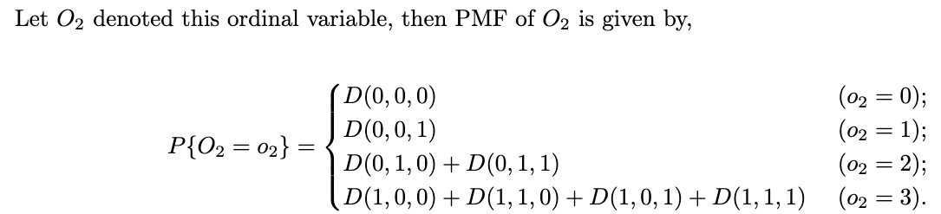
Section 3: Plan for Paper 1 - Power Consideration of Ordinal Composite Endpoints
3.2 Proposed Work Based on Joint Distribution of the Binary Components
3.2.3 Derive the Distribution of Ordinal Composite (Cont.)
E.g., for a trivariate case,
Ordinal – ranked by severity, assign severity score 3, 2, 1 to Component 3, 2, 1:
Ordinal – ranked by severity, assign severity score 3, 2, 1 to Component 1, 2, 3:
Notes:
Panagiotelis, Anastasios, Claudia Czado, and Harry Joe. "Pair copula constructions for multivariate discrete data." Journal of the American Statistical Association 107.499 (2012): 1063-1072.
Brechmann, Eike Christian, and Ulf Schepsmeier. "Modeling dependence with C-and D-vine copulas: the R package CDVine." Journal of statistical software 52 (2013): 1-27.
Lin, Huihui, and Chaganty, N. Rao. "Multivariate distributions of correlated binary variables generated by pair-copulas." Journal of Statistical Distributions and Applications 8.1 (2021): 1-14.
Vine Copula:
Vine copulas, or pair-copula constructions, are an extension of the basic copula concept. They offer a more flexible framework for modeling complex and high-dimensional dependence structures. The idea is to decompose a multivariate distribution into a cascade of bivariate copulas, which are easier to understand and estimate.
In vine copula models, the multivariate dependence structure is represented as a graphical model, which consists of a sequence of trees. Each tree captures different levels of interactions among the variables: the first tree captures direct dependencies between pairs of variables, and subsequent trees capture conditional dependencies given variables already linked in previous trees.
https://hudsonthames.org/a-practical-intro-to-vine-copula/
Solution 2: find theoretical form for the joint distribution of the components and derive the proportion of each category of the ordinal variable based on different ways of combining the components.
Timeline:
Oral: 12/12
Two weeks ahead for sharing materials
Manuscript for JCTS
Ordinal composite outcome
Start with simulation result
Start working on the draft.
Derive theoretical form to improve current power calculation
Rerun simulation by introducing correlation.
Show current analytical form assuming independence is biased
Plan of application on Treatnow.
Results from application
Plan for next meeting
Treatnow data what can be used.
Manuscript: Formula derivation
For a specific copula
Formula for ordinal composite

Slide 38
Section 3: Plan for Paper 1 - Power Consideration of Ordinal Composite Endpoints
3.2 Proposed Work Based on Joint Distribution of the Binary Components
3.2.4 Next Steps for Paper 1
Generalize the distribution formula for more than 3 binary variables
Implement the method with R software
Existing R function helping to generate correlated binary variables: “simstudy:::.findRhoBin()”
Existing R packages about Copula and Vine-Copula, need to check if they are directly applicable in our study
Package “copula”; Package “vinecopula”; Package “CDVine”
Apply the proposed method to the simulation study, and compare with previous empirical results
Apply the proposed method to the real-world dataset(s)
Trial of Early Antiviral Therapies during Non-hospitalized Outpatient Window (TREAT NOW) - A study of Lopinavir/ritonavir vs placebo for the early treatment of COVID-19 in non-hospitalized patients.
Primary outcome: a modified COVID-19 ordinal outcomes scale, from 1. Death to 7. Not hospitalized without symptoms nor limitation in activity
Covariates: age, gender, and duration of acute respiratory infection symptoms prior to randomization.
Notes:
Model: Bayesian longitudinal proportional odds model
TREAT NOW is an adaptive, blinded, multi-center, placebo-controlled superiority randomized clinical trial
TREAT NOW is an outpatient multi-center study with enrollment restricted to the USA.
How to generate correlated binary components:
Pearson, used for two quantitative continuous variables which have a linear relationship
Spearman, used for two quantitative variables if the link is partially linear, or for one qualitative ordinal variable and one quantitative variable
Kendall, often used for two qualitative ordinal variables
We will use pearson correlation.
A Pearson correlation coefficient estimated for two binary variables will return the phi coefficient.^{[4]}
Which is also a valid measure of association for two binary variables.
Spearman
We now present the Spearman correlation coefficient, also referred as Spearman’s rank correlation coefficient. This coefficient is actually the same than Pearson coefficient, except that the computations are based on the ranked values rather than on the raw observations.
Kendall
Kendall coefficient correlation, also known as Kendall’s τ� coefficient, is similar than Spearman coefficient, except that it is often preferred for small samples and when many rank ties.
Previous slide is where I am regarding paper1, this is next steps for papers
Get their feedback of any other potential work they think are interesting.
Plan: first hour will be presentation combined with questions.

Slide 39
THANK YOU!

Slide 40
Reference
1. Sankoh AJ, Li H, D’Agostino Sr RB. Use of composite endpoints in clinical trials. Statistics in Medicine 2014; 33(27): 4709–4714.
2. Califf RM, Harrelson-Woodlief L, Topol EJ. Left ventricular ejection fraction may not be useful as an end point of thrombolytic therapy comparative trials. Circulation American Heart Association, 1990; 82(5): 1847–1853.
3. Braunwald E, Cannon CP, McCabe CH. Use of composite endpoints in thrombolysis trials of acute myocardial infarction. The American Journal of Cardiology 1993; 72(19): G3–G12.
4. Ferreira-González I, Busse JW, Heels-Ansdell D, et al. Problems with use of composite end points in cardiovascular trials: systematic review of randomised controlled trials. BMJ (Clinical research ed.) 2007; 334(7597): 786.
5. Hussain A, Misra A, Bozkurt B. Endpoints in Heart Failure Drug Development. Cardiac Failure Review 2022; 8: e01.
6. Fox K, Ford I, Steg PG, Tendera M, Ferrari R, BEAUTIFUL Investigators. Ivabradine for patients with stable coronary artery disease and left-ventricular systolic dysfunction (BEAUTIFUL): a randomised, double-blind, placebo-controlled trial. Lancet (London, England) 2008; 372(9641): 807–816.
7. Boden WE, van Gilst WH, Scheldewaert RG, et al. Diltiazem in acute myocardial infarction treated with thrombolytic agents: a randomised placebo-controlled trial. Incomplete Infarction Trial of European Research Collaborators Evaluating Prognosis post-Thrombolysis (INTERCEPT). Lancet (London, England) 2000; 355(9217): 1751–1756.
8. Brugaletta S, Gomez-Lara J, Ortega-Paz L, et al. 10-Year Follow-Up of Patients With Everolimus-Eluting Versus Bare-Metal Stents After ST-Segment Elevation Myocardial Infarction. Journal of the American College of Cardiology 2021; 77(9): 1165–1178.
9. Lindenfeld J, Zile MR, Desai AS, et al. Haemodynamic-guided management of heart failure (GUIDE-HF): a randomised controlled trial. Lancet (London, England) 2021; 398(10304): 991–1001.
10. Packer M. Proposal for a new clinical end point to evaluate the efficacy of drugs and devices in the treatment of chronic heart failure. Journal of Cardiac Failure 2001; 7(2): 176–182.
11. Packer M. Development and Evolution of a Hierarchical Clinical Composite End Point for the Evaluation of Drugs and Devices for Acute and Chronic Heart Failure: A 20-Year Perspective. Circulation 2016; 134(21): 1664–1678.
12. Food and Drug Administration. Treatment for Heart Failure: Endpoints for Drug Development Guidance for Industry. FDA, 2020 [cited October 4, 2023]. (https://www.fda.gov/regulatory-information/search-fda-guidance-documents/treatment-heart-failure-endpoints-drug-development-guidance-industry).
13. Pocock SJ, Ariti CA, Collier TJ, Wang D. The win ratio: a new approach to the analysis of composite endpoints in clinical trials based on clinical priorities. European Heart Journal 2012; 33(2): 176–182.
14. O’Brien PC. Procedures for comparing samples with multiple endpoints. Biometrics 1984; 40(4): 1079–1087.
Notes:
Thanks for attending! Before this slide.
Eye contact

Slide 41
Reference （partial list）
15. Felker GM, Anstrom KJ, Rogers JG. A global ranking approach to end points in trials of mechanical circulatory support devices. Journal of Cardiac Failure 2008; 14(5): 368–372.
16. U.S. Department of Health and Human Services FDA Center for Drug Evaluation and Research, U.S. Department of Health and Human Services FDA Center for Biologics Evaluation and Research, U.S. Department of Health and Human Services FDA Center for Devices and Radiological Health. Guidance for industry: patient-reported outcome measures: use in medical product development to support labeling claims: draft guidance. Health and Quality of Life Outcomes 2006; 4(1): 79.
17. WHO R&D Blueprint novel Coronavirus COVID-19 Therapeutic Trial Synopsis. [cited October 4, 2023]. (https://www.who.int/docs/default-source/blue-print/covid-19-therapeutic-trial-synopsis.pdf?sfvrsn=44b83344_1&download=true).
18. Thorlund K, Smith D, Linsell C, et al. The importance of appropriate selection of clinical endpoints in outpatient COVID-19 clinical trials. Communications Medicine Nature Publishing Group, 2023; 3(1): 1–5.
19. Felker GM, Pang PS, Adams KF, et al. Clinical Trials of Pharmacological Therapies in Acute Heart Failure Syndromes. Circulation: Heart Failure American Heart Association, 2010; 3(2): 314–325.
20. WHO Working Group on the Clinical Characterisation and Management of COVID-19 infection. A minimal common outcome measure set for COVID-19 clinical research. The Lancet. Infectious Diseases 2020; 20(8): e192–e197.
21. Anastasios Panagiotelis, Claudia Czado, and Harry Joe. “Pair copula constructions for multivariate discrete data”. In: Journal of the American Statistical Association 107.499 (2012), pp. 1063–1072.
22. M Sklar. “Fonctions de r ́epartition `a n dimensions et leurs marges”. In: Annales de l’ISUP. Vol. 8. 3. 1959, pp. 229–231.
23. John Whitehead. “Sample size calculations for ordered categorical data”. In: Statistics in medicine 12.24 (1993), pp. 2257–2271.
24. Horita, Nobuyuki, and Takeshi Fukumoto. "Global case fatality rate from COVID‐19 has decreased by 96.8% during 2.5 years of the pandemic." Journal of Medical Virology 95.1 (2023).
25. Goff Jr, David Calvin, et al. "Bending the curve in cardiovascular disease mortality: Bethesda+ 40 and beyond." Circulation 143.8 (2021): 837-851.
Notes:
Thanks for attending! Before this slide.
Eye contact

Slide 42
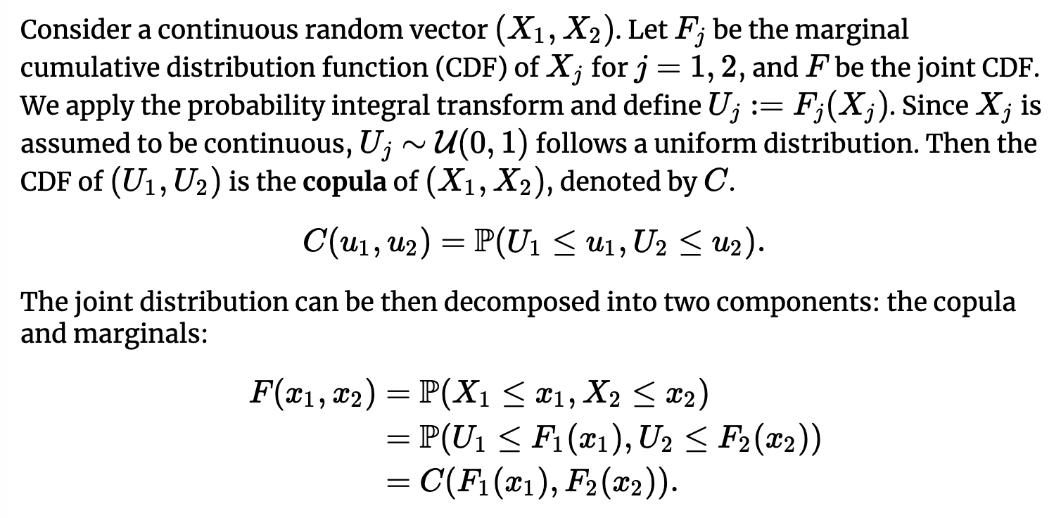
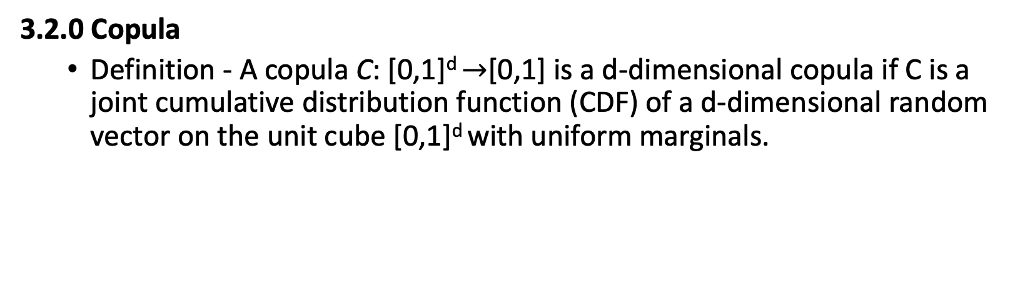
Supplementary
3.2.0 Copula
Definition - A copula C: [0,1]^{d} $→$[0,1] is a d-dimensional copula if C is a joint cumulative distribution function (CDF) of a d-dimensional random vector on the unit cube [0,1]^{d} with uniform marginals.

Slide 43
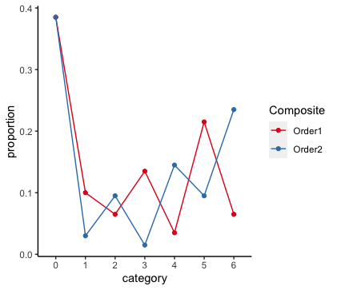
Section 2: Simulation Study - Understand the Power of Composite Endpoints related to Components
2.2.2 Binary Components & Binary/Ordinal Composite
2.2.2.2 Simulation Result (Cont.)
Proportion of components in composite outcome 3 (order 1) and 4 (order 2) under one simulation
Recall:
6 Binary Components
Prevalence for binary 1, binary 2, binary 3, binary 4, binary 5, binary 6 are
10%, 20%, 10%, 20%, 10%, 20%.
Treatment effect: have no, small, or medium effect for different binary single outcomes
1,2: no treatment effect: 0
3,4: small treatment effect: log(0.8)
5,6: medium treatment effect: log(0.6)
Order 1: assign severity score 6 to component 1,…, score 1 to component 6.
Order 2: assign severity score 6 to component 6,…, score 1 to component 1.
Whenever component 6 is 1
Whenever component 1 is 1
Whenever component 3 is 1, while component 1 and 2 are 0.
Notes:
This distribution can provide some intuition of why composite order 1 has lower power than composite order 2.
From simulation_new.R
Value of comp_Y3==6 => at least component 1 is 1.
Value of comp_Y4==6 => at least component 6 is 1.
Here composite 3 has lower density of 6 than composite 4, since component 1 has lower prevalence than component 6
Combination of effect size and prevalence.
As sample size increases, power increases.
Outcome 1 with no effect always has the lowest power, except for the case where all beta X’s being 0.
We know that higher event rate and larger effect size will increase power. Which can be seen from:
1. Same effect size: For outcomes with same non-zero betas (penal 2 and 3), from the pattern of circles and triangles of outcome 2 and 3. circles always go upwards, triangle always go downwards.
Same prevalence: squares and rhombus in panel 4 and 5

Slide 44
Section 3: Plan for Paper 1 - Power Consideration of Ordinal Composite Endpoints
3.1 Existing Methods and Limitations
3.1.0 Reason for Focusing on Ordinal Composite
There are plenty of work of statistical consideration on time-to-event and binary composites. For example,
Time-to-Event
Gómez, Guadalupe, and Stephen W. Lagakos. "Statistical considerations when using a composite endpoint for comparing treatment groups." Statistics in Medicine 32.5 (2013): 719-738.
Binary
Gómez, Guadalupe, and Stephen W. Lagakos. "Statistical considerations when using a composite endpoint for comparing treatment groups." Statistics in Medicine 32.5 (2013): 719-738.
Ordinal composites are increasingly adopted in clinical trials but little has been written regarding the statistical consideration of ordinal composites.
Notes:
This is a major formula people use to calculate the power of ordinal variables.
And also is what Frank use in his package.
Power of ordinal variable
Whitehead J. Sample size calculations for ordered categorical data. Stat Med. 1993 Dec 30;12(24):2257-71. doi: 10.1002/sim.4780122404. Erratum in: Stat Med 1994 Apr 30;13(8):871. PMID: 8134732.
Requires knowing the distribution (that is the proportion of patients who will fall into each category of response) of the ordinal variable
Solution 1: estimate by simulation, i.e., empirical distribution
Solution 2: find theoretical formula to calculate the distribution of ordinal composite based on distribution of individual components. (say: in reality data around individual component is more likely to be available; solution 2 is our direction)
Timeline:
Oral: 12/12
Two weeks ahead for sharing materials
Manuscript for JCTS
Ordinal composite outcome
Start with simulation result
Start working on the draft.
Derive theoretical form to improve current power calculation
Rerun simulation by introducing correlation.
Show current analytical form assuming independence is biased
Plan of application on Treatnow.
Results from application
Plan for next meeting
Treatnow data what can be used.
Manuscript: Formula derivation
For a specific copula
Formula for ordinal composite

Slide 45
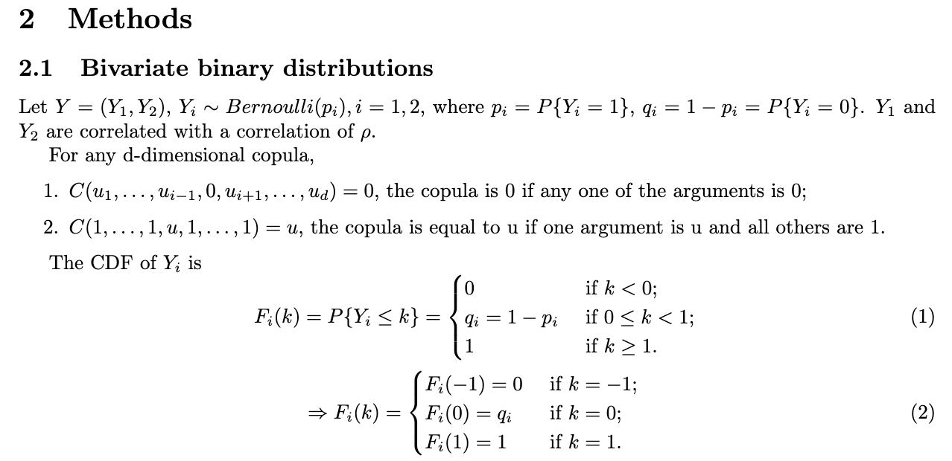
Section 3: Plan for Paper 1 - Power Consideration of Ordinal Composite Endpoints
3.2 Proposed Work Based on Joint Distribution of the Binary Components
3.2.3 Partial Draft of Paper 1 Method Session
Notes:
SAY: THIS IS EXISTING WORK OF …
IF THERE ARE PLENTY OF TIME, CAN GO THROUGH SOME DETAILS.
TRY TO CONVEY THE IDEA, DON’T READ THE NOTATION. GENERAL IDEA ABOUT IT.
DON’T WANT TO READ
https://hudsonthames.org/a-practical-intro-to-vine-copula/
Solution 2: find theoretical form for the joint distribution of the components and derive the proportion of each category of the ordinal variable based on different ways of combining the components.
Timeline:
Oral: 12/12
Two weeks ahead for sharing materials
Manuscript for JCTS
Ordinal composite outcome
Start with simulation result
Start working on the draft.
Derive theoretical form to improve current power calculation
Rerun simulation by introducing correlation.
Show current analytical form assuming independence is biased
Plan of application on Treatnow.
Results from application
Plan for next meeting
Treatnow data what can be used.
Manuscript: Formula derivation
For a specific copula
Formula for ordinal composite

Slide 46
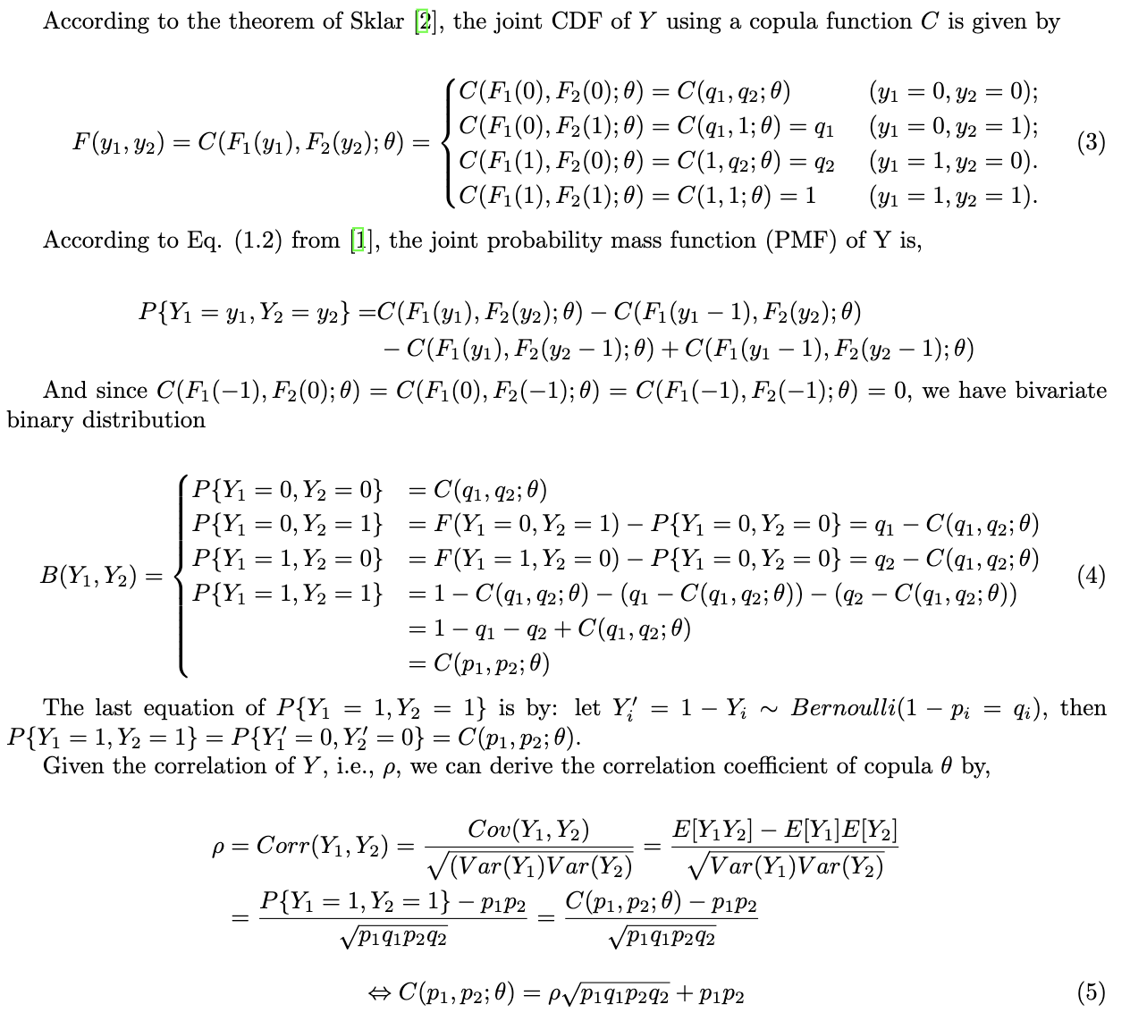
Section 3: Plan for Paper 1 - Power Consideration of Ordinal Composite Endpoints
3.2 Proposed Work Based on Joint Distribution of the Binary Components
3.2.3 Partial Draft of Paper 1 Method Session (Cont.)
Notes:
https://hudsonthames.org/a-practical-intro-to-vine-copula/
Solution 2: find theoretical form for the joint distribution of the components and derive the proportion of each category of the ordinal variable based on different ways of combining the components.
Timeline:
Oral: 12/12
Two weeks ahead for sharing materials
Manuscript for JCTS
Ordinal composite outcome
Start with simulation result
Start working on the draft.
Derive theoretical form to improve current power calculation
Rerun simulation by introducing correlation.
Show current analytical form assuming independence is biased
Plan of application on Treatnow.
Results from application
Plan for next meeting
Treatnow data what can be used.
Manuscript: Formula derivation
For a specific copula
Formula for ordinal composite

Slide 47
Section 3: Plan for Paper 1 - Power Consideration of Ordinal Composite Endpoints
3.2 Proposed Work Based on Joint Distribution of the Binary Components
3.2.3 Partial Draft of Paper 1 Method Session (Cont.)
Notes:
https://hudsonthames.org/a-practical-intro-to-vine-copula/
Solution 2: find theoretical form for the joint distribution of the components and derive the proportion of each category of the ordinal variable based on different ways of combining the components.
Timeline:
Oral: 12/12
Two weeks ahead for sharing materials
Manuscript for JCTS
Ordinal composite outcome
Start with simulation result
Start working on the draft.
Derive theoretical form to improve current power calculation
Rerun simulation by introducing correlation.
Show current analytical form assuming independence is biased
Plan of application on Treatnow.
Results from application
Plan for next meeting
Treatnow data what can be used.
Manuscript: Formula derivation
For a specific copula
Formula for ordinal composite

Slide 48
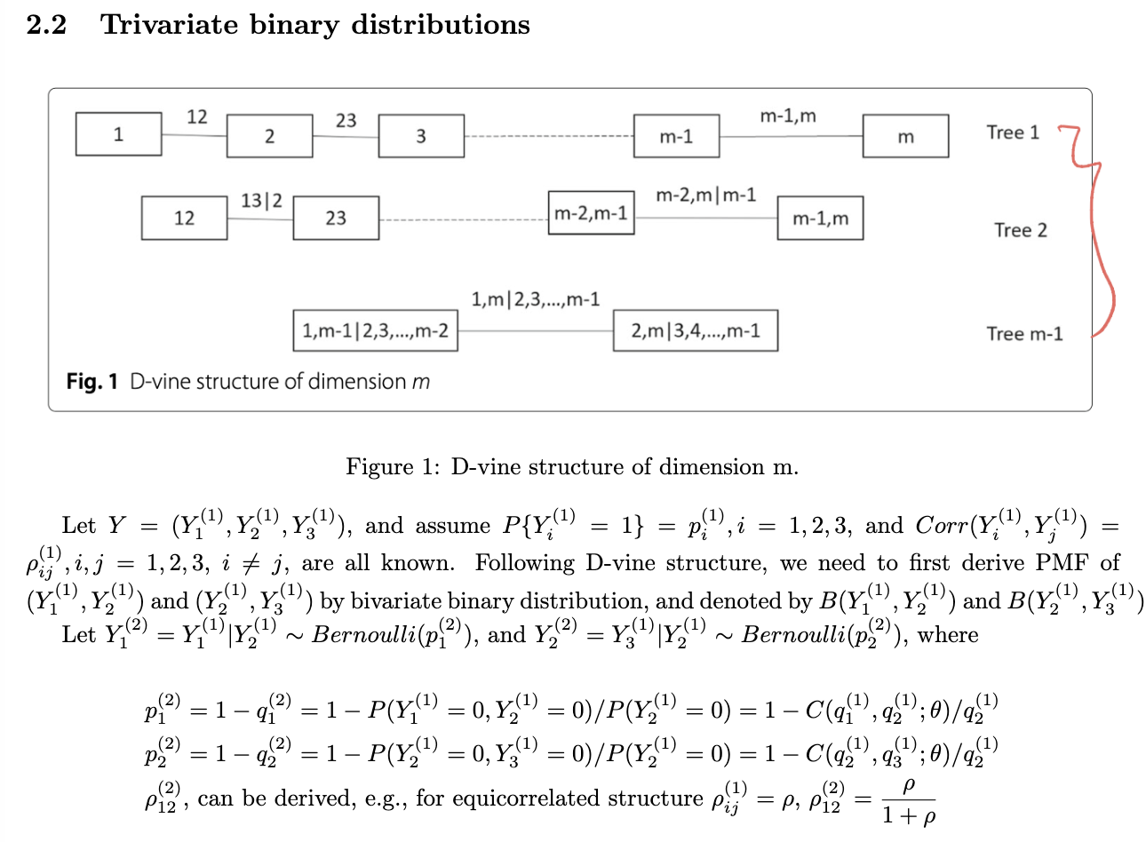
Section 3: Plan for Paper 1 - Power Consideration of Ordinal Composite Endpoints
3.2 Proposed Work Based on Joint Distribution of the Binary Components
3.2.3 Partial Draft of Paper 1 Method Session (Cont.)
Notes:
https://hudsonthames.org/a-practical-intro-to-vine-copula/
Solution 2: find theoretical form for the joint distribution of the components and derive the proportion of each category of the ordinal variable based on different ways of combining the components.
Timeline:
Oral: 12/12
Two weeks ahead for sharing materials
Manuscript for JCTS
Ordinal composite outcome
Start with simulation result
Start working on the draft.
Derive theoretical form to improve current power calculation
Rerun simulation by introducing correlation.
Show current analytical form assuming independence is biased
Plan of application on Treatnow.
Results from application
Plan for next meeting
Treatnow data what can be used.
Manuscript: Formula derivation
For a specific copula
Formula for ordinal composite

Slide 49
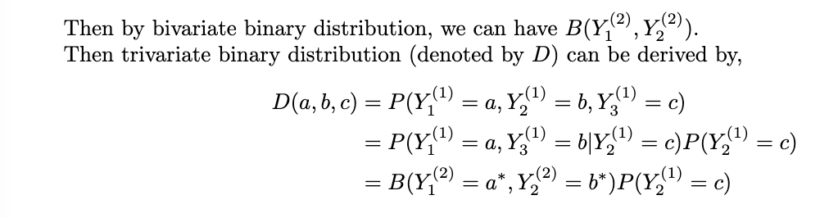
Section 3: Plan for Paper 1 - Power Consideration of Ordinal Composite Endpoints
3.2 Proposed Work Based on Joint Distribution of the Binary Components
3.2.3 Partial Draft of Paper 1 Method Session (Cont.)
Notes:
https://hudsonthames.org/a-practical-intro-to-vine-copula/
Solution 2: find theoretical form for the joint distribution of the components and derive the proportion of each category of the ordinal variable based on different ways of combining the components.
Timeline:
Oral: 12/12
Two weeks ahead for sharing materials
Manuscript for JCTS
Ordinal composite outcome
Start with simulation result
Start working on the draft.
Derive theoretical form to improve current power calculation
Rerun simulation by introducing correlation.
Show current analytical form assuming independence is biased
Plan of application on Treatnow.
Results from application
Plan for next meeting
Treatnow data what can be used.
Manuscript: Formula derivation
For a specific copula
Formula for ordinal composite

